Slide 1
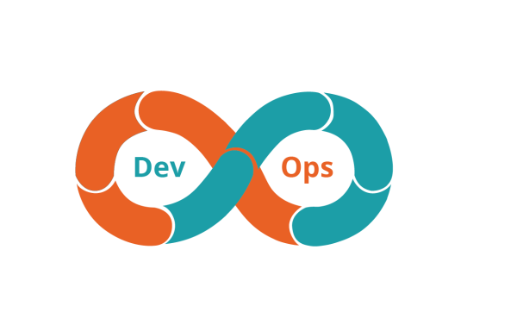
Docker Containerization Boot Camp

Slide 2
Welcome!
Logistics (breaks, facilities, lunch, etc.)
Rules of Engagement
Introductions
Let’s Get Started!
Notes:
Resources for running Kubernetes & practicing Microservices on a Microsoft cloud:
https://docs.microsoft.com/en-us/azure/container-service/kubernetes/container-service-kubernetes-windows-walkthrough
https://hackernoon.com/kubernetes-adventures-on-azure-part-2-windows-cluster-and-trick-for-scaling-pods-27e769edde15
A few key agenda items:
Microservice patterns – 1 service per container/per host
Database per container
Rete limiting
API Gateway
Strangler pattern
Convert monolith into Microservice
Customer model
Inventory service
Example: Spin up monolith and break it up

Slide 3

Who is your instructor?
A little about me…

Slide 4
Introductions
Name & Role
Team, Group, or Department
Expectations for the class?
Something interesting about yourself?

Slide 5
What to Expect from this Class
Flexibility
Conversations
Literacy and awareness on many of the principles, tools, and practices surrounding Docker as part of a DevOps architecture.
An effort to focus on your own situations and challenges so you can act on what you learn.

Slide 6
Introduction to Docker
Part 1

Slide 7
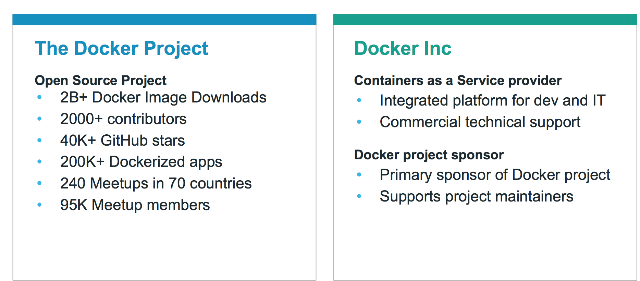
What is Docker?
Notes:
Page 7
NOTES:

Slide 8
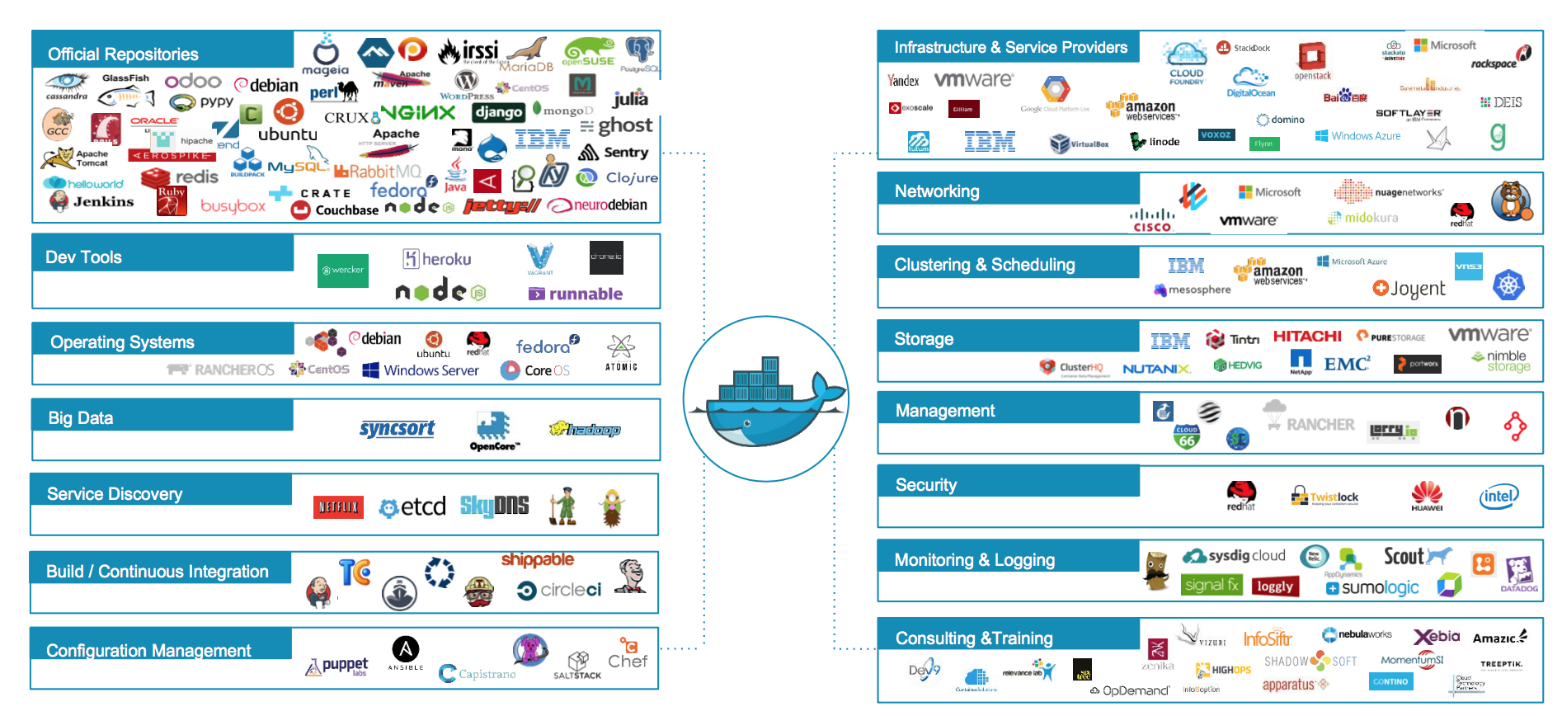
Docker Ecosystem
Notes:
Page 8
Official Repositories - These are repositories of popular commercial and open-source software and systems that are maintained by their “Official” providers. THese undergo special vetting, static analysis for malware, and are usually among the best-documented container images.

Slide 9

Docker Basics
Docker Image
The basis of a Docker container
Docker Container
The standard unit in which the application service resides
Docker Engine
Creates, ships and runs Docker containers deployable on physical or virtual host locally, in a datacenter or cloud service provider
Docker Registry
On-premises registry for image storing and collaboration
Notes:
Page 9
A Docker image is a read-only template with instructions for creating a Docker container. For example, an image might contain an Ubuntu operating system with Apache web server and your web application installed. You can build or update images from scratch or download and use images created by others. An image may be based on, or may extend, one or more other images. A docker image is described in text file called a Dockerfile, which has a simple, well-defined syntax.
A Docker container is a runnable instance of a Docker image. You can run, start, stop, move, or delete a container using Docker API or CLI commands. When you run a container, you can provide configuration metadata such as networking information or environment variables. Each container is an isolated and secure application platform, but can be given access to resources running in a different host or container, as well as persistent storage or databases.

Slide 10
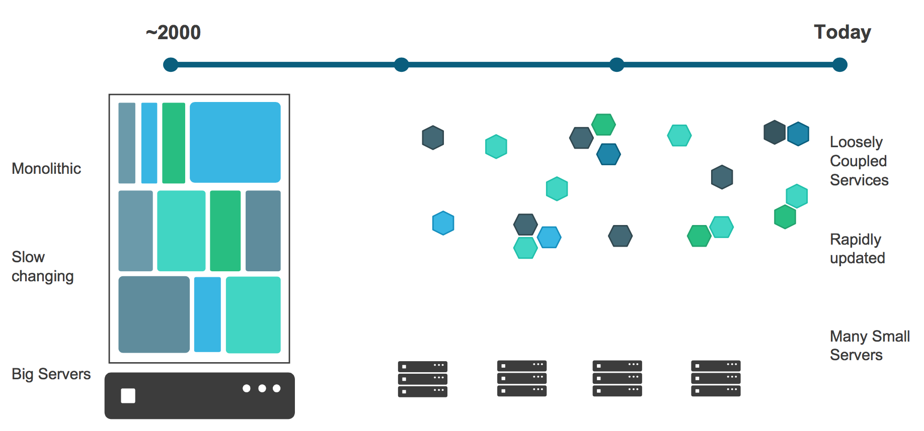
Application Evolution
Notes:
Management of software has changed radically in this time too:
We used to have big up-front specifications for “projects” that represented yearly releases, and deadlines were frequently missed.
Now we have Agile development… “projects” are mostly gone and instead we have ever-changing “products” with a much-tighter release schedule… sometimes multiple times per day.
Page 10

Slide 11
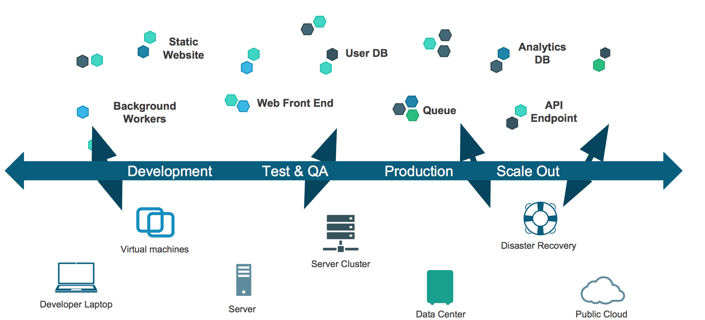
Challenge: The Dependency Matrix
“It works on MY machine.”
Notes:
Course content © 2017 TechTown | Licensed for Classroom Distribution Only | All Other Rights Reserved
Page 11
A common problem for developers is the difficulty of managing all their application's dependencies in a simple and automated way.
This is usually difficult for several reasons:
Cross-platform dependencies. Modern applications often depend on a combination of system libraries and binaries, language-specific packages, framework-specific modules, internal components developed for another project, etc. These dependencies live in different "worlds" and require different tools - these tools typically don't work well with each other, requiring awkward custom integrations.
Conflicting dependencies. Different applications may depend on different versions of the same dependency. Packaging tools handle these situations with various degrees of ease - but they all handle them in different and incompatible ways, which again forces the developer to do extra work.
Custom dependencies. A developer may need to prepare a custom version of their application's dependency. Some packaging systems can handle custom versions of a dependency, others can't - and all of them handle it differently.
Continued on next page…

Slide 12
Notes
Notes:
Docker solves the problem of dependency hell by giving the developer a simple way to express all their application's dependencies in one place, while streamlining the process of assembling them. If this makes you think of XKCD 927, don't worry. Docker doesn't replace your favorite packaging systems. It simply orchestrates their use in a simple and repeatable way. How does it do that? With layers.
Docker defines a build as running a sequence of Unix commands, one after the other, in the same container. Build commands modify the contents of the container (usually by installing new files on the filesystem), the next command modifies it some more, etc. Since each build command inherits the result of the previous commands, the order in which the commands are executed expresses dependencies.
Here's a typical Docker build process:
FROM ubuntu:12.04 RUN apt-get update && apt-get install -y python python-pip curl RUN curl -sSL https://github.com/shykes/helloflask/archive/master.tar.gz | tar -xzv RUN cd helloflask-master && pip install -r requirements.txt
Note that Docker doesn't care how dependencies are built - as long as they can be built by running a Unix command in a container.
Reference: https://github.com/docker/docker

Slide 13
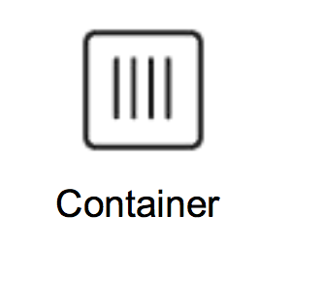
Containers as a Solution
Packages up software binaries and dependencies
Isolates software from each other
Container is a standard format
Easily portable across environment
Allows ecosystem to develop around its standard
Notes:
Page 13
NOTES:

Slide 14
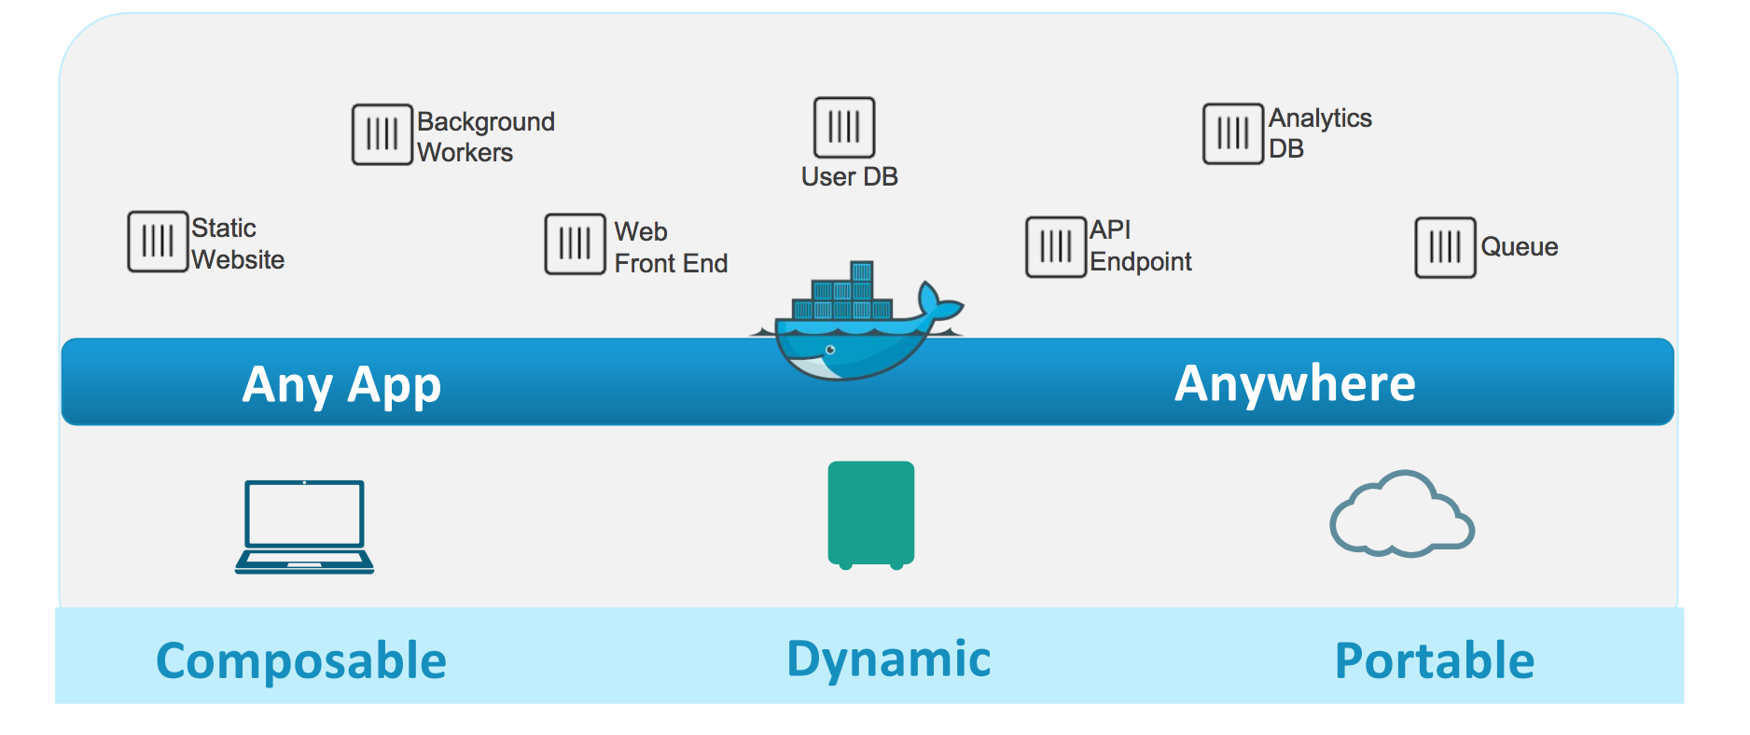
Containers as a Solution
Notes:
Page 14
NOTES:

Slide 15
Developer Benefits
Build once...(finally) run anywhere
A clean, safe, hygienic and portable runtime environment for your app.
No worries about missing dependencies, packages and other pain points during subsequent deployments.
Run each app in its own isolated container, so you can run various versions of libraries and other dependencies for each app without worrying
Automate testing, integration, packaging...anything you can script
Reduce/eliminate concerns about compatibility on different platforms, either your own or your customers.
Cheap, zero-penalty containers to deploy services? A VM without the overhead of a VM? Instant replay and reset of image snapshots? That’s the power of Docker
Notes:
Page 15
Reference: https://www.slideshare.net/dotCloud/why-docker2bisv4
One big driver for the initial adoption of Docker has been startups in an effort to drive down their Cloud Bill. There is lots of anecdotal evidence of startups cutting their cloud bill in half by using Docker to increase utilization. Instead of having a single VM for a database for example, putting a database, mid tier and front end container all in the same VM thus using less resources overall.

Slide 16
Operational Benefits
Configure once...run anything
Make the entire lifecycle more efficient, consistent, and repeatable
Increase the quality of code produced by developers.
Eliminate inconsistencies between development, test, production, and customer environments
Support segregation of duties
Significantly improves the speed and reliability of continuous deployment and continuous integration systems
Because the containers are so lightweight, address significant performance, costs, deployment, and portability issues normally associated with VM
Notes:
Page 16
NOTES:
Reference: https://www.slideshare.net/dotCloud/why-docker2bisv4

Slide 17

VMs vs. Containers
Notes:
Page 17
A badly kept secret on cloud is the over-provisioning of VMs for workloads. The average CPU utilization on the average data center VM is between 6-12% and this is part of the reason for a very healthy ecosystem of cloud consultants.
Containers are more lightweight and are typically filled with higher density workloads.
https://gigaom.com/2013/11/30/the-sorry-state-of-server-utilization-and-the-impending-post-hypervisor-era/

Slide 18
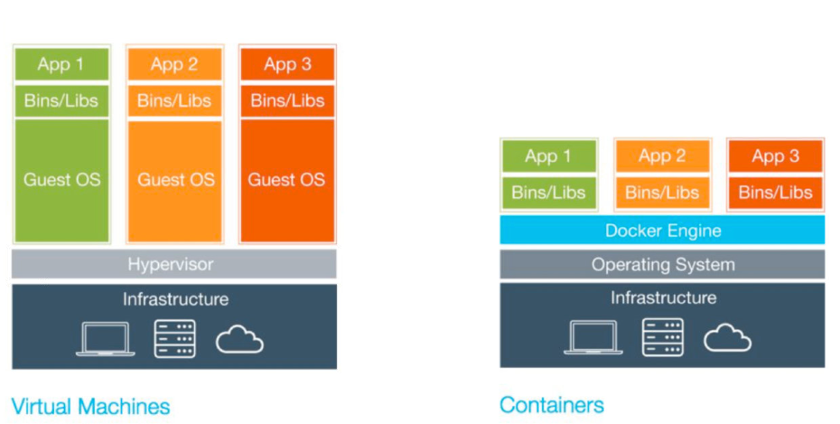
VMs vs. Containers
Notes:
Page 18
NOTES:

Slide 19
VMs vs. Containers
Virtual Machines (VMs) | Containers
Represents hardware-level virtualization | Represents operating system virtualization
Heavyweight | Lightweight
Slow provisioning | Real-time provisioning and scalability
Limited performance | Native performance
Fully isolated and therefore more secure (maybe) | Process-level isolation and therefore less secure (maybe)
Notes:
Page 19
Size: VMs are very large which makes them impractical to store and transfer.
Performance: running VMs consumes significant CPU and memory, which makes them impractical in many scenarios, for example local development of multi-tier applications, and large-scale deployment of cpu and memory-intensive applications on large numbers of machines.
Portability: competing VM environments don't play well with each other. Although conversion tools do exist, they are limited and add even more overhead.
Hardware-centric: VMs were designed with machine operators in mind, not software developers. As a result, they offer very limited tooling for what developers need most: building, testing and running their software. For example, VMs offer no facilities for application versioning, monitoring, configuration, logging or service discovery.
Reference: https://github.com/docker/docker

Slide 20
VMs vs. Containers
Simulates a physical machine
Provides a local file system
Can be accessed over a network
Full and independent guest operating system
Virtualized device drivers
Strong resource and memory management
Huge memory foot-print
Needs a hypervisor
Notes:
Page 20
The first three layers (black items) are those that are essentially shared by both VM and Container approaches. The balance of the list describes elements (mostly cons) specific to true Virtual Machines.

Slide 21
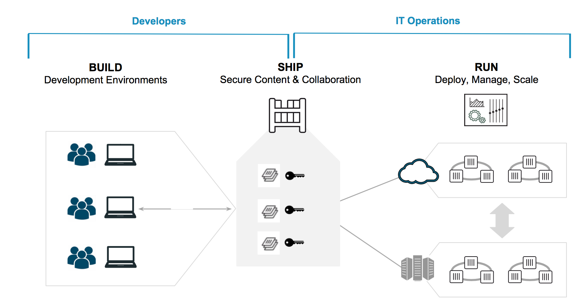
Dev/Ops Container Workflow
Notes:
Page 21
NOTES:

Slide 22
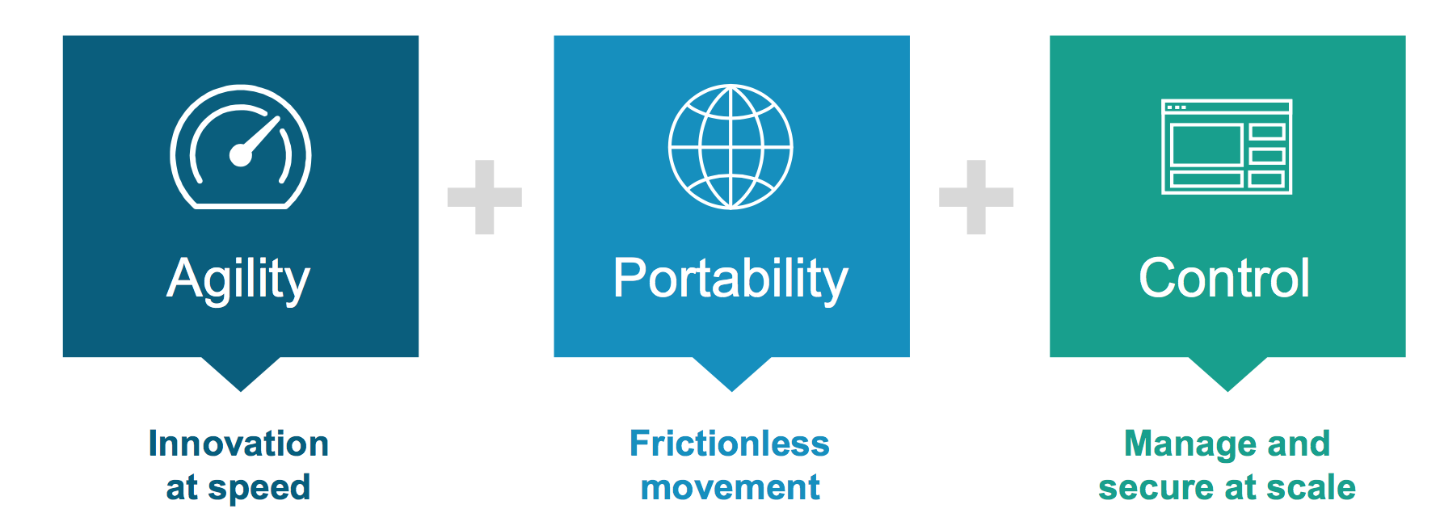
Container Benefits
Notes:
Page 22
NOTES:

Slide 23
Docker CE vs. Docker EE
 | COMMUNITY EDITION | ENTERPRISE EDITION BASIC | ENTERPRISE EDITION STANDARD | ENTERPRISE EDITION ADVANCED
Container engine and built in orchestration, networking, security | ✓ | ✓ | ✓ | ✓
Docker Certified - Infrastructure, Plugins and ISV Containers |  | ✓ | ✓ | ✓
Image Management (private registry, caching) | Cloud hosted repos |  | ✓ | ✓
Docker Datacenter - Integrated container app management |  |  | ✓ | ✓
Docker Datacenter - Multi-tenancy with RBAC, LDAP/AD support |  |  | ✓ | ✓
Integrated secrets mgmt, image signing policy |  |  | ✓ | ✓
Image security scanning | Preview |  |  | ✓
Support | Community | Biz Day or 24x7 | Biz Day or 24x7 | Biz Day or 24x7
Pricing | Free | $750/node/year | $1,500/node/year | $2,000/node/year
Notes:
Page 23
We will be using Community Edition exclusively for our in-class work, but it’s valuable to know the differences.

Slide 24
Installing Docker
Docker container engine is built from and on top of the Linux kernel, so it needs Linux to run natively*
Docker is increasingly being packaged with newer Linux distributions
Docker is also available on MacOS and Windows through the use of lightweight Linux VMs - HyperV-based on Windows, HyperKit-based on MacOS
Native Windows containers can also be used with Docker for Windows if you have very specific versions of Windows.
https://github.com/shekhar2010us/docker_bootcamp/blob/master/exercise/docker_installation.md
Notes:
Page 24
NOTES:

Slide 25

Prerequisite: Connect to Classroom VM
CLASSROOM WORK
$ ssh student@FQDN
student password = DockerStudentPW0
FQDN = The fully qualified domain name of the machine assigned to you by your instructor. This will commonly be in the form docker#.domain.com (where # is your student number as assigned to you by your instructor).
Notes:
Page 25

Slide 26
Prerequisite: Add & Update Repos
CLASSROOM WORK
Also at
https://docs.docker.com/engine/installation/
$ sudo apt-get -y install apt-transport-https ca-certificates curl
$ curl -fsSL https://download.docker.com/linux/ubuntu/gpg | sudo apt-key add -
$ sudo add-apt-repository \
"deb [arch=amd64] https://download.docker.com/linux/ubuntu \
$(lsb_release -cs) \
stable"
$ sudo apt-get update
Notes:
Page 26
Set up the repository
Install packages (if necessary) to allow apt to use a repository over HTTPS:
$ sudo apt-get -y install apt-transport-https ca-certificates curl
Add Docker’s official GPG key:
$ curl -fsSL https://download.docker.com/linux/ubuntu/gpg | sudo apt-key add -
Use the following command to set up the stable repository.
Note: The lsb_release -cs sub-command below returns the name of your Ubuntu distribution, such as xenial.
$ sudo add-apt-repository \
"deb [arch=amd64] https://download.docker.com/linux/ubuntu \
$(lsb_release -cs) \
stable"

Slide 27
Install Docker-CE
CLASSROOM WORK
Also at
https://docs.docker.com/engine/installation/
$ sudo apt-get -y install docker-ce
$ sudo docker run hello-world
Notes:
Install docker Community Edition
$ sudo apt-get -y install docker-ce
Verify docker is installed correctly
$ sudo docker run hello-world
This command downloads a test image and runs it in a container. When the container runs, it prints an informational message. Then, it exits.
Page 27

Slide 28
Installing Docker Script
It’s good to install Docker the “hard” way at least once so you understand what is involved.
There is a Docker-maintained community script that will install the latest release on your Linux machine (most popular flavors) available at https://get.docker.com/
Run ‘curl -sSL https://get.docker.com/ | sh’ in your terminal
The script will also install a Union File System driver and verify Docker engine functionality
Notes:
Page 28
Docker is a fast moving project, and often critical bugs are fixed in newer versions. When working with Docker it is best to work with latest when possible.
Have students visit https://get.docker.com to see that it is a full script… we are passing the script to sh for execution.

Slide 29
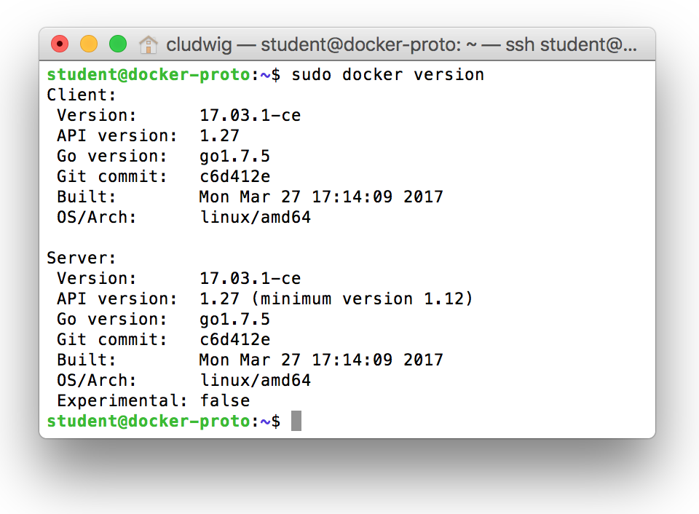
Docker Basics
$ sudo docker version
Notes:
Page 29
Starting with v17.03.0-ce, Docker is on a monthly release cycle and uses a new YY.MM versioning scheme to reflect this. Two channels are available: monthly and quarterly.
Any given monthly release will only receive security and bugfixes until the next monthly release is available. Quarterly releases receive security and bugfixes for 4 months after
initial release. This release includes bugfixes for 1.13.1 but there are no major feature additions and the API version stays the same.
Docker version is useful for troubleshooting as well. The Server version will not be available if the Docker engine service is not running, which is a great place to start if you find docker commands are hanging or being unresponsive.
$ sudo service docker start # start the service

Slide 30
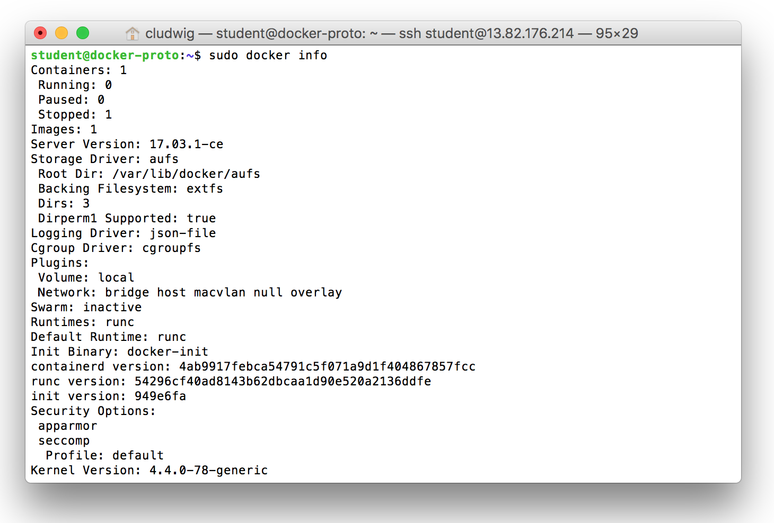
Docker Basics
$ sudo docker info
Notes:
Provides a number of pieces of engine and system information.
Page 30

Slide 31
Docker Basics
Standard command format:
docker [NOUN] verb
$ sudo docker --help #displays help and management subcommands (nouns)
$ sudo docker NOUN --help
There are reasonable defaults and short forms of option flags for many things. i.e.:
“docker pull” assumes “image”
“docker stop” assumes “container”
can use “img” instead of “image”
can use “con” instead of “container”, etc.
Notes:
Page 31
NOTES:

Slide 32
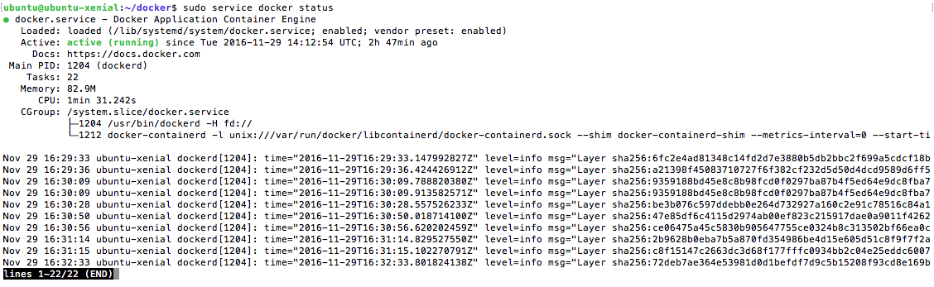
Docker Basics
Determine the status of the Docker service
$ sudo service docker status
Notes:
Page 32
Also a great starting point if Docker is unresponsive.
$ sudo service docker start # start the service

Slide 33
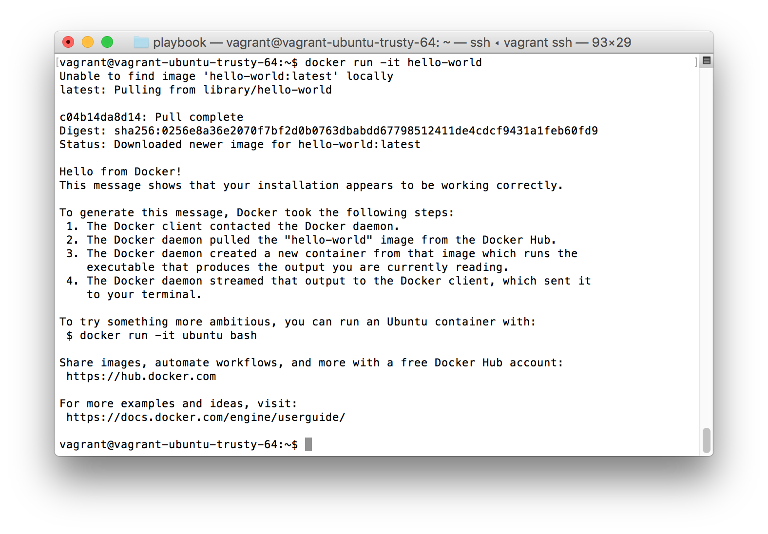
Docker Hello World(s)
Notes:
Page 33
docker run -it hello-world
This will likely NOT work at first… must use sudo. We will fix that soon.

Slide 34
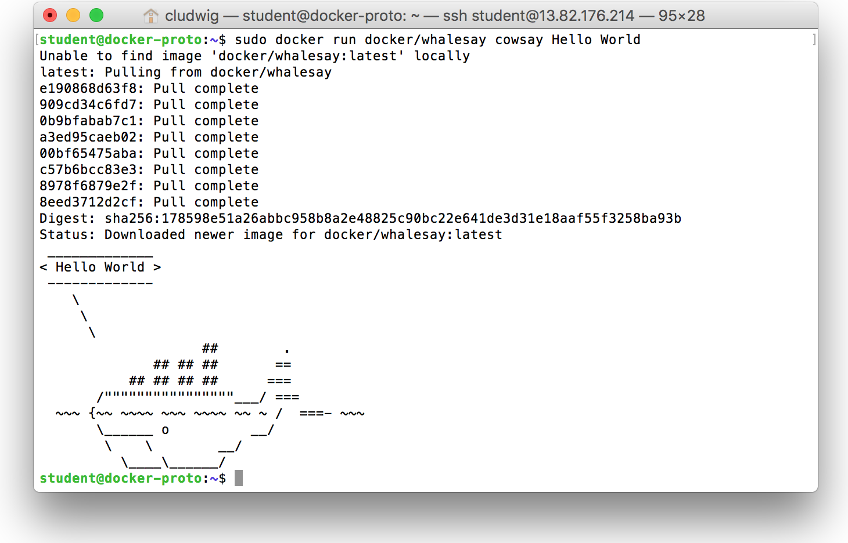
Docker Hello World(s)
$ sudo docker run docker/whalesay cowsay Hello World
Notes:
Page 34
$ sudo docker run docker/whalesay cowsay Hello World

Slide 35
Docker Hello World(s)
Tells docker to run a cmd in container
Cmd to run inside
container
docker run docker/whalesay cowsay Hello World
Base image for
container
Argument to
Cowsay cmd
Notes:
Page 35
NOTES:

Slide 36

What is ‘Docker Engine’?
Notes:
Page 36
The CLI uses the Docker REST API to control or interact with the Docker daemon through scripting or direct CLI commands. Many other Docker applications use the underlying API and CLI.
The daemon creates and manages Docker objects, such as images, containers, networks, and data volumes.

Slide 37
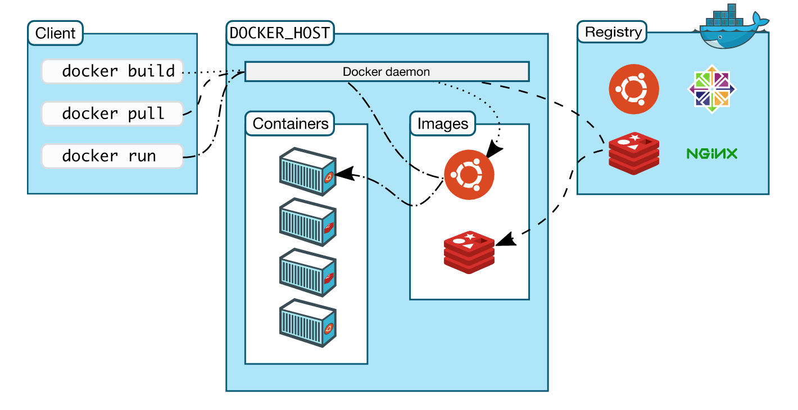
How is Docker Architected?
Notes:
Page 37
Docker uses a client-server architecture. The Docker client talks to the Docker daemon, which does the heavy lifting of building, running, and distributing your Docker containers. The Docker client and daemon can run on the same system, or you can connect a Docker client to a remote Docker daemon. The Docker client and daemon communicate via sockets or through a REST API.
Note: The Docker daemon runs with root privileges which introduces an attack opportunity. More behind this: https://docs.docker.com/engine/security/security/

Slide 38
Docker is Built on Foundational Tech
cgroup and namespacing capabilities of the Linux kernel
Libcontainer Library Specification
(namespaces, filesystem, resources, security, etc)
Go programming language
(written in Go)
Docker Image Specification
(for container image management)
Notes:
Page 38
cgroups (abbreviated from control groups) is a Linux kernel feature that limits, accounts for, and isolates the resource usage (CPU, memory, disk I/O, network, etc.) of a collection of processes. Engineers at Google (primarily Paul Menage and Rohit Seth) started the work on this feature in 2006 under the name "process containers".
Namespaces are a feature of the Linux kernel that isolates and virtualizes system resources of a collection of processes. Examples of resources that can be virtualized include process IDs, hostnames, user IDs, network access, interprocess communication, and filesystems. Namespaces are a fundamental aspect of containers on Linux.

Slide 39
No ‘sudo’ Configuration
Run docker without sudo
https://docs.docker.com/engine/installation/linux/linux-postinstall/
Create Docker group:
$ sudo groupadd docker
Add your user to docker group:
$ sudo usermod -aG docker $USER
Log out and log back in:
$ exit # then log back in
Notes:
Newer installs do this for you, but of course you still have to logout and back in.

Slide 40
Docker Webapp & Hello World
CLASSROOM WORK
Exercise 2.1 in Docker Labs
https://github.com/shekhar2010us/docker_bootcamp/blob/master/exercise/exercise2.1-webapps.md
Notes:
https://github.com/shekhar2010us/docker_bootcamp/blob/master/exercise/exercise2.1-webapps.md
Page 40

Slide 41
Docker Images
Part 2

Slide 42
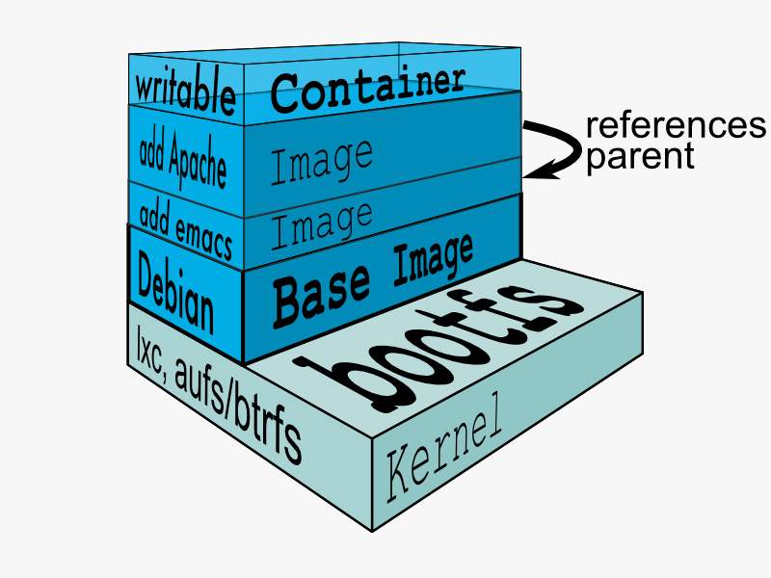
Docker Union File System
AuFS (AnotherUnionFS) is a multi-layered filesystem that implements union mount
Allows several filesystems or directories to be simultaneously mounted and visible through a single mount point
Appears to be one filesystem to the end user
Notes:
Page 42
Union file systems, or UnionFS, are file systems that operate by creating layers, making them very lightweight and fast. Docker Engine uses UnionFS to provide the building blocks for containers. Docker Engine can use multiple UnionFS variants, including AUFS (the default for Ubuntu), btrfs, vfs, and DeviceMapper (the default for Red Hat and Centos.
How AuFS Works
1.Mount a base image as read-only
2.Add read-write file system over read-only file system
3.Change some files and directories to top as read- write file system
4.It is committed
5.Save incremental files and directories in new image
6.Mount the image as read-only and add read-write file system on top

Slide 43
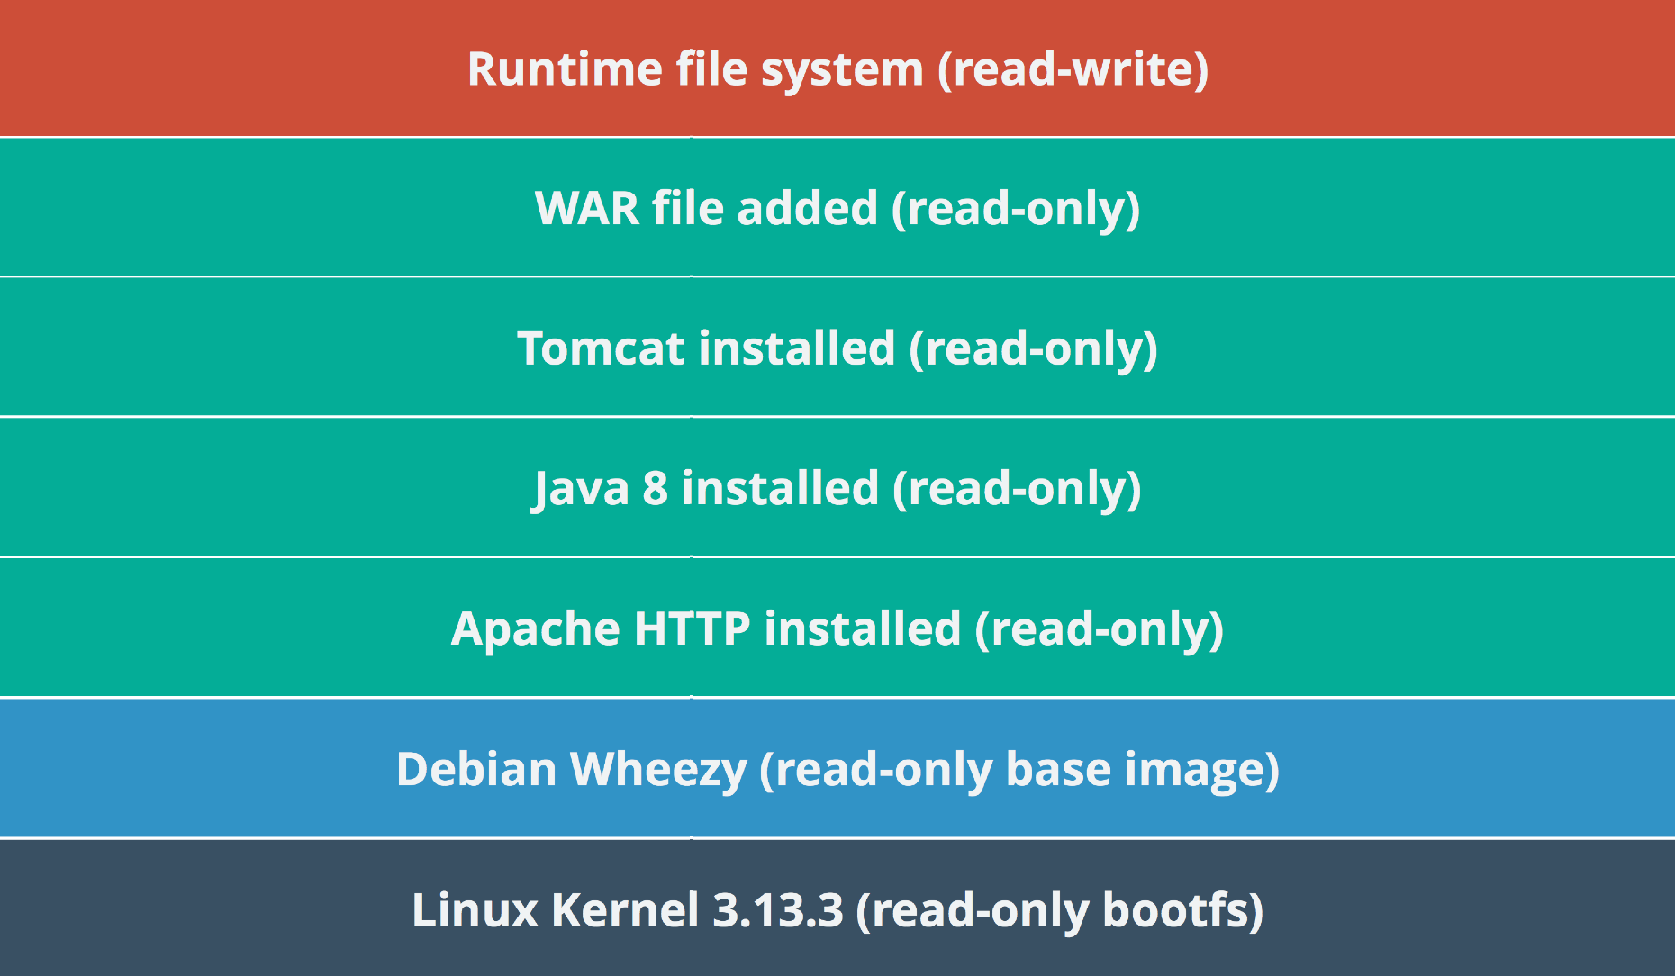
Example Docker Layers
Docker Layer – Each Docker image is composed of a series of layers. Docker uses Union File Systems to combine these into a single image. The combination of these layers gives the illusion of a traditional file system. Only the top layer is writeable.
Notes:
Page 43
NOTES:

Slide 44
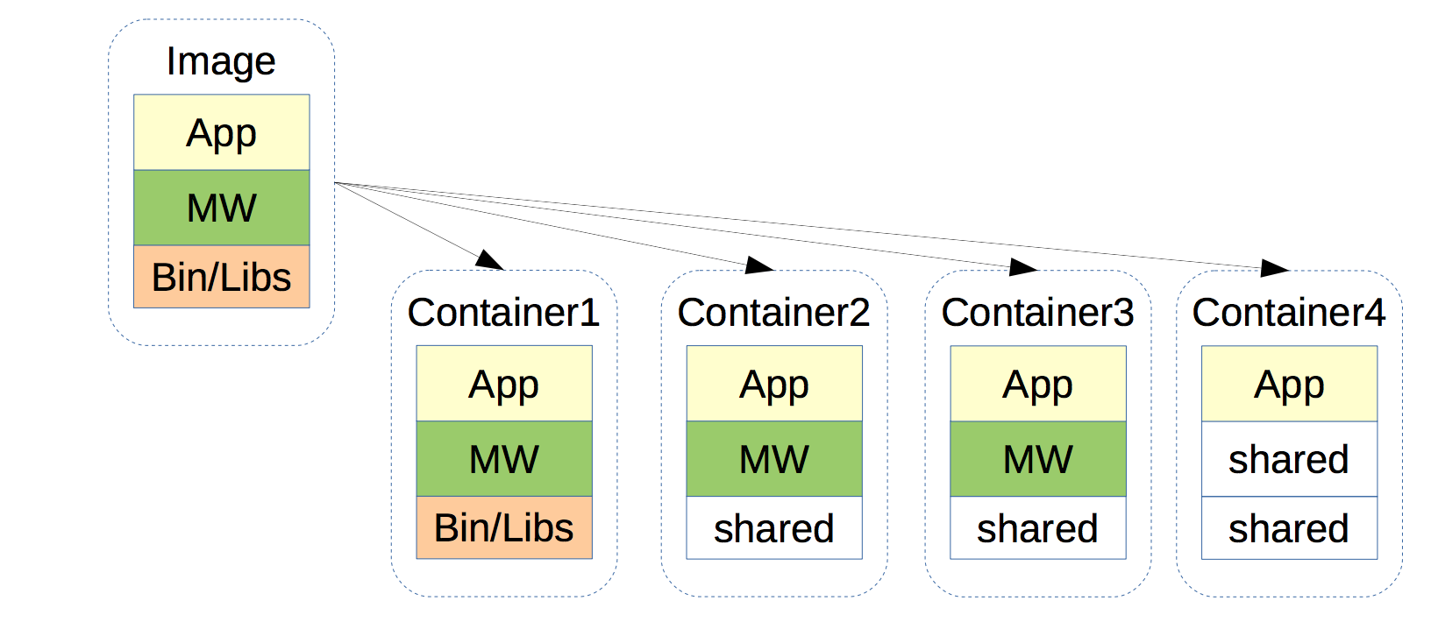
Benefits of Union File Systems
Files are shared across containers
Storage and memory spaces are saved
Faster deployment of containers
Notes:
Page 44
NOTES:

Slide 45
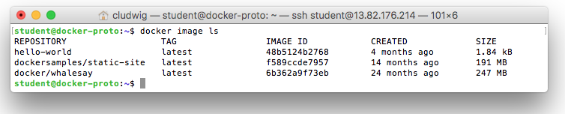
$ docker image ls
Notes:
Displays all local images.
Alternative:
$ docker images #old-style syntax (prior to 1.13)
Page 45

Slide 46
Docker Hub
Docker’s first-party cloud-based registry
Hosts a broad repository of Docker images
Contains nearly any popular open source technology including MariaDB, Jenkins, Cloudera, etc
Contains ‘Official images’ from vendors such as Canonical, Oracle, Red Hat, etc
Provides one free private Docker repo, more for a paid subscription
Notes:
Page 46
NOTES:

Slide 47
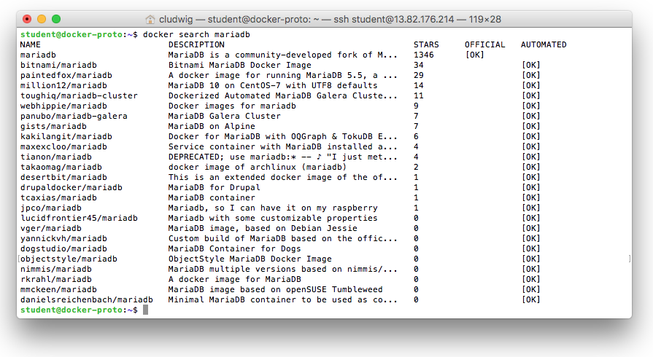
$ docker search [searchterm]
Notes:
Page 47
$ docker search mariadb
Look for “Official” images.
Look for images that the community upvotes with “Stars”

Slide 48
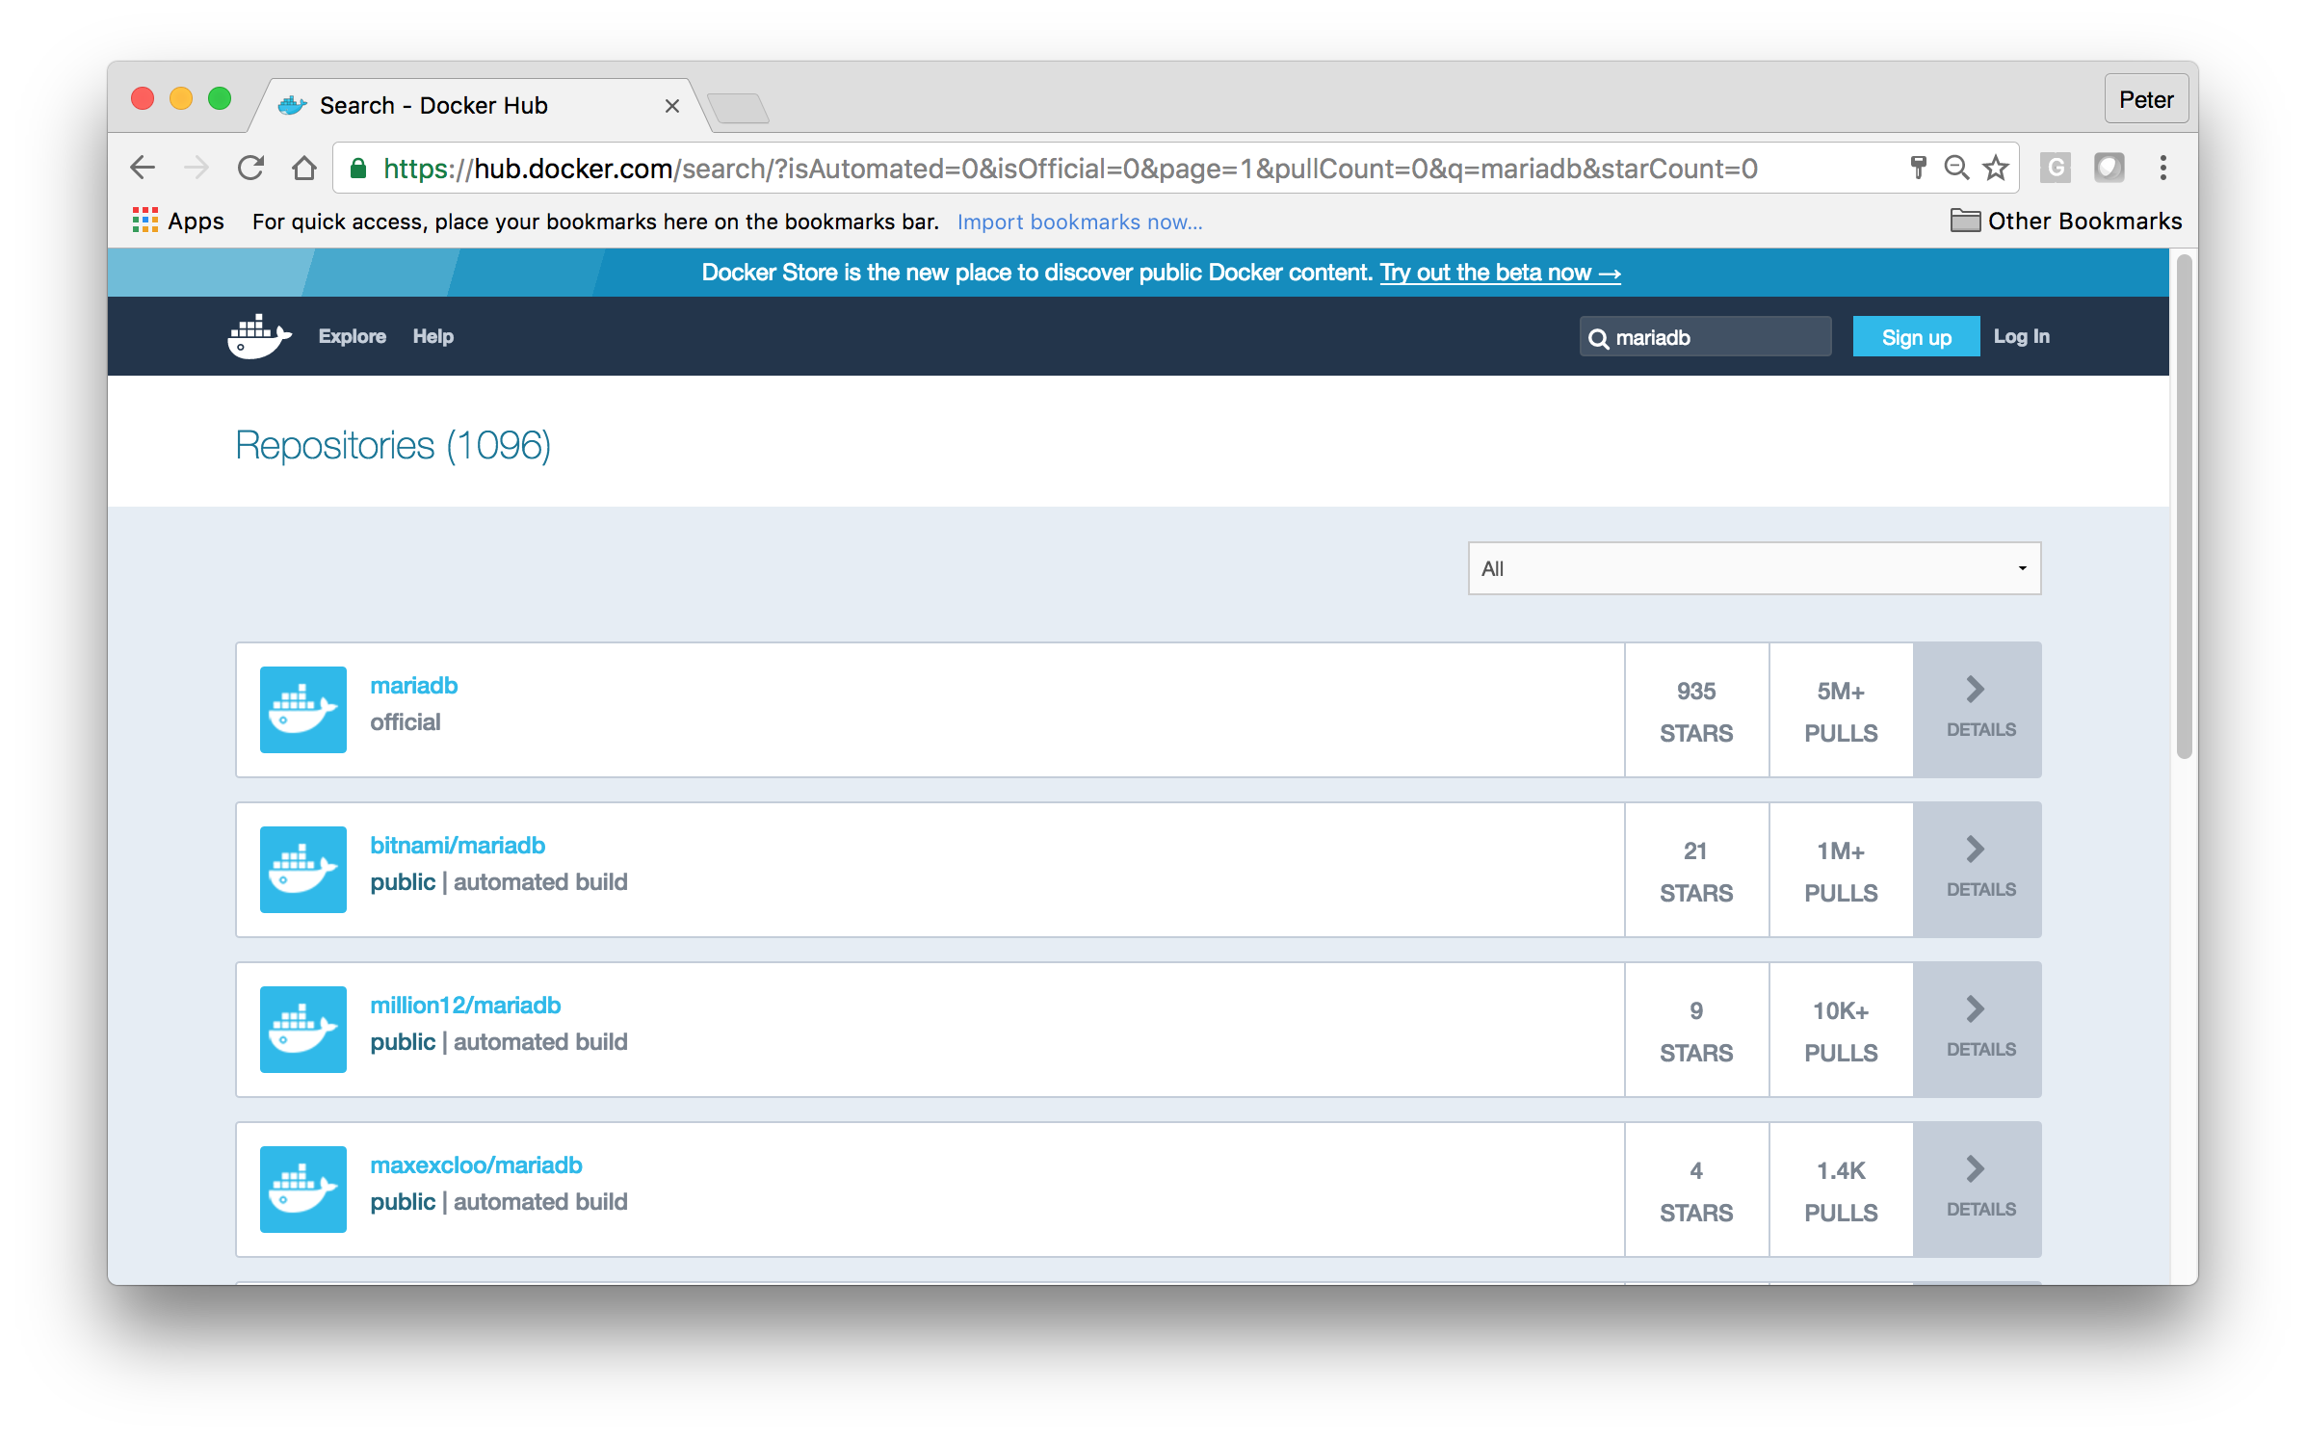
Docker Hub Equivalent
Notes:
Page 48
NOTES:

Slide 49
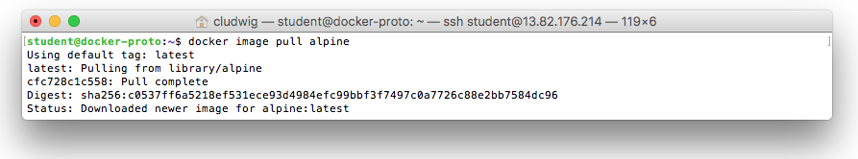
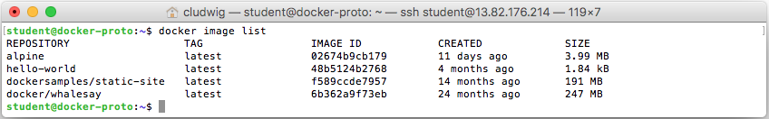
$ docker image pull [imageName]
Best Practice: Choose the smallest base images possible
Debian – 123 MB
Alpine – 5 MB
Notes:
Page 49
NOTES:

Slide 50
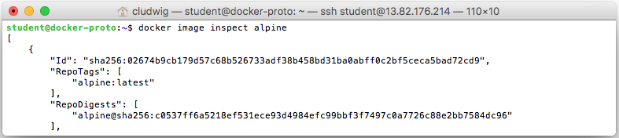
$ docker image inspect [imagename]
ID The unique identifier for the container
State This stanza has various status flags and the process id for the container. Using the ExitCode from this State element a graceful shutdown or recovery process could be initiated. The following format will return just the ExitCode of the most recently run container:
docker inspect -f '{{.State.ExitCode}}' $(docker ps -lq)
Image The image this container is running.
NetworkSettings The network environment for the container and therefore for the application(s) within the image.
Notes:
Page 50
It can be useful to narrow down information from docker inspect with grep as well

Slide 51
$ docker image inspect [imagename] (continued)
LogPath The system path to this container's log file.
RestartCount Keeps track of the number of times the container has been restarted. This value is the key value used when defining a container's restart policy..
Name The user defined name for the container.
Volumes Defines the volume mapping between the host system and the container.
HostConfig Key configurations for how the container will interact with the host system. These could take CPU and memory limits, networking values, or device driver paths.
Config The runtime configuration options set when the docker run command was executed. Part of this configuration is another "Image" value. This image {{.Config.Image}} is the tagged image which may be different than the image listed in {{.Image}}
Notes:
Page 51

Slide 52
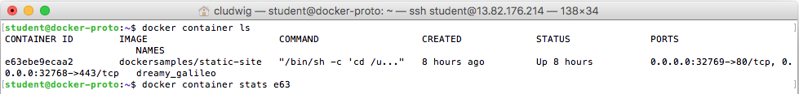
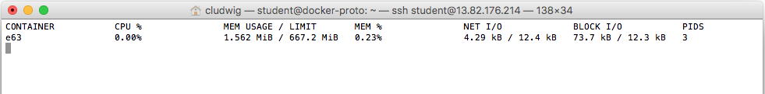
$docker container stats
Provides the CPU, memory, network, and other monitoring KPI’s of a docker container.
Multiple containers can be profiled as well
All containers can be profiled by leaving out the container id(s)
Notes:
Page 52
NOTES:

Slide 53
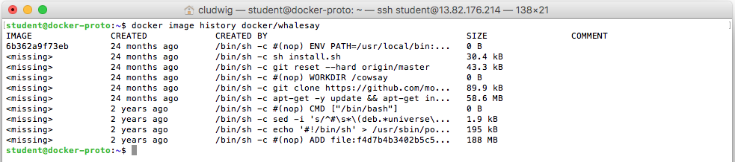
$ docker image history docker/whalesay
Use history to view layers in an image
Notes:
Page 53
NOTES:

Slide 54
Removing Docker Containers & Images
#!/bin/bash
# Remove all stopped containers
docker container prune [-f]
# Remove all unused images
docker image prune [-f] [-a]
-f option skips confirmation.
-a option (for images) removes ALL unused images, not just those that were left behind when a container was removed (dangling).
Best Practice: Prevent image inflation and regularly clean up images
Notes:
Page 54
NOTES:

Slide 55
Docker Files
Part 3

Slide 56
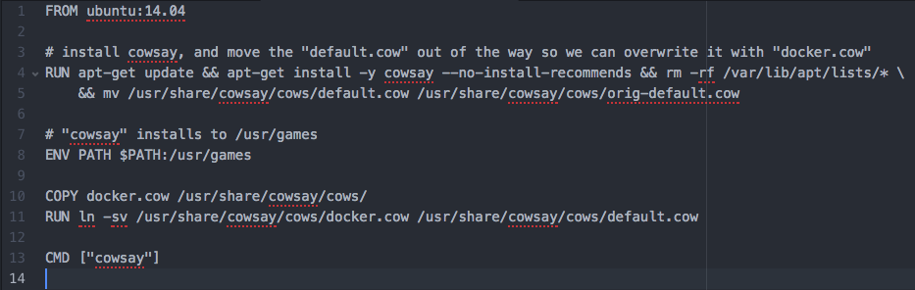
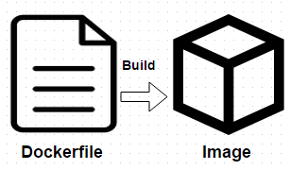
Dockerfile
Docker images are built, layer by layer, from a base image
Images are composed of layers, each with a simple command such as
Run a shell command
Add a file or directory
Create an environment variable
Modify permissions
Execute process or script
Notes:
Page 56
NOTES:

Slide 57
Dockerfile
Dockerfile format
#Comment
INSTRUCTION arguments
FROM command
The first instruction in a Dockerfile is a FROM command, to specify the Image from which you are building from.
FROM <image>
FROM <Image>:<tag>
FROM ubuntu:14.04
Notes:
Page 57
NOTES:

Slide 58
Dockerfile
MAINTAINER command
This lets you know who to consult (or blame) for any dockerfile issues
MAINTAINER Santa Claus
Santa@northpole.org
ENV command
Used to provide environment variables for containers.
ENV <key> <value>
ENV AWS-KEY 123ABC12345ABCDEF
Notes:
Page 58
NOTES:

Slide 59
Dockerfile
RUN command
Executes commands and commits the results in a new layer.
RUN <command>
RUN apt-get update
CMD command
Can only be one in a dockerfile. The CMD instruction provides defaults to an executing container and can be overridden with arguments to docker run.
CMD [“cowsay”]
Notes:
Page 59
NOTES:

Slide 60
Dockerfile
ADD/COPY command
Places files onto a file system. ADD performs the same as copy, but also allows the <src> to be a URL. It will also unpack recognized compression formats.
COPY <src> <dest>
ADD <src> <dest>
EXPOSE command
Informs Docker that the container listens on a network port at runtime. Ports of a container are still not accessible to the host unless –p flag is passed to the Docker run command when the container is invoked.
Notes:
Page 60
NOTES:

Slide 61
Dockerfile
Best Practices for writing Dockerfiles:
Use .dockerignore to exclude any unnecessary files and improve Docker’s performance
Run a single process per container to simplify scale and reuse
Minimize layers per container
Sharing base images is a common pattern among development teams
When possible, base from tiny images such as Alpine Linux
Specify version in FROM statements when container is destined for production
Notes:
Page 61
More here: https://docs.docker.com/engine/userguide/eng-image/dockerfile_best-practices/

Slide 62
Dockerfile
Dockerfile build syntax
docker build .
docker build -t <namespace/image name:versiontag> /path
docker build -t myname/jenkins .
Then run the newly created image
docker run –t myname/jenkins
Notes:
Page 62
-t (--tag): assign tag
Be aware that when you run ’docker build .’, all files in the current folder get uploaded to docker engine. This may be undesirable, and use of .dockerignore will assist with this situation.

Slide 63
Dockerfile Exercises
CLASSROOM WORK
Exercise 2.2 & 2.3 in Docker Labs
https://github.com/shekhar2010us/docker_bootcamp/blob/master/exercise/exercise2.1-webapps.md
NB: You can skip the second part of step 2.3.4 (“Push Your Image”) unless you want to first create yourself an account at hub.docker.com.
Notes:
https://github.com/shekhar2010us/docker_bootcamp/blob/master/exercise/exercise2.1-webapps.md
Page 63

Slide 64
Dockerfile Optimization
3.1 CLASSROOM WORK
This exercise covers optimizing dockerfile to reduce the number of layers
https://github.com/shekhar2010us/docker_bootcamp/blob/master/exercise/exercise3.1-dockerfile-optimization.md
Notes:
https://github.com/shekhar2010us/docker_bootcamp/blob/master/exercise/exercise3.1-dockerfile-optimization.md
Page 64

Slide 65
Multi-Stage Build
New as of Docker 17.05
Allows “ship artifacts, not build environments”
Ideal for languages like Go, where binaries are built in a heavyweight environment, but can ship the binary in a lightweight container.
# first stage does the building
# for UX purposes, I'm naming this stage `build-stage`
FROM golang:1.8 as build-stage
WORKDIR /go/src/github.com/codeship/go-hello-world
COPY hello-world.go .
RUN go build -o hello-world .
# starting second stage
FROM alpine:latest
# copy the binary from the `build-stage`
COPY --from=build-stage /go/src/github.com/codeship/go-hello-world/hello-world /bin
CMD hello-world
$ docker images
REPOSITORY TAG IMAGE ID CREATED SIZE
single-stage latest 58328409dbf7 2 minutes ago 704MB
multi-stage latest 9af3c2a2bf40 23 minutes ago 5.54MB
Notes:
https://github.com/codeship/go-hello-world
Page 65

Slide 66
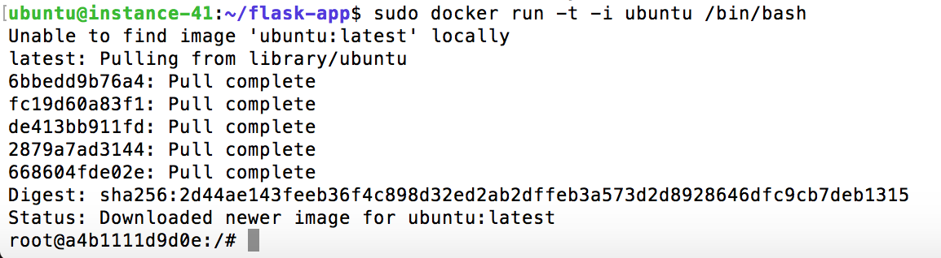
Docker Interactive Mode
Best Practice: Run containers in interactive mode while developing docker images
Notes:
Page 66
NOTES:

Slide 67
Docker Interactive Mode
Create a terminal
To use
docker run -t -i ubuntu /bin/bash
Interactive mode
Notes:
As we’ve seen, we can combine these two options to the more common -it
Page 67

Slide 68
Docker Interactive Mode
Attach to a running container and shell instance
docker attach some_container #by Name
Attach to a running container by starting a new shell instance
docker exec -it some_container /bin/bash #by Name
Notes:
Page 68
NOTES:

Slide 69
Docker Interactive Mode
Quick Tip: Be aware that alpine and other distros may have a different entry point (sh vs bash)
docker run -it alpine /bin/sh
Notes:
Page 69
NOTES:

Slide 70
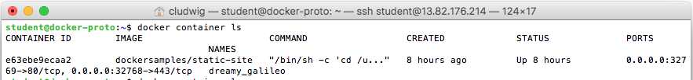
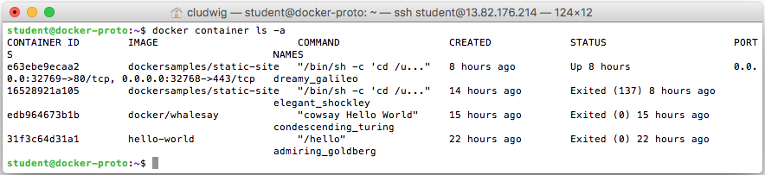
See All Containers
$ docker container ls #show running containers
$ docker container ls -a #show all containers (including running, stopped, exited, etc.)
Notes:
Page 70
NOTES:

Slide 71
Docker Hub/Ghost
CLASSROOM WORK
Assignment - Standup a ghost web server and connect to it with your browser
Notes:
Answer:
Find ‘ghost’ on Docker Hub
https://hub.docker.com/_/ghost/
2. Read instructions and execute the docker run command with ghost
docker run --name some-ghost -p 8080:2368 -d ghost
3. Navigate to <lp>:8080 and observe the running web server
Bonus: Run ’docker top <container id>’ against the ghost container to observe running processes
Docker is extremely useful for web servers. You don’t have to worry about dependencies, incompatible versions, setting environment variables, just call and run. Any service that exposes itself over TCP can be containerized and easily run.
Page 71

Slide 72
Docker Hub/MariaDB
CLASSROOM WORK
Assignment - Standup a mariaDB database and connect to it’s command line prompt.
Bonus: Stand up a NOSQL database and connect to it (Cassandra, MongoDB, etc)
Notes:
Answer:
docker run --name some-mariadb -e MYSQL_ROOT_PASSWORD=my-secret-pw -d mariadb:latest
docker run -it --link some-mariadb:mysql --rm mariadb sh -c 'exec mysql -h"$MYSQL_PORT_3306_TCP_ADDR" -P"$MYSQL_PORT_3306_TCP_PORT" -uroot -p"$MYSQL_ENV_MYSQL_ROOT_PASSWORD"'
Page 72

Slide 73

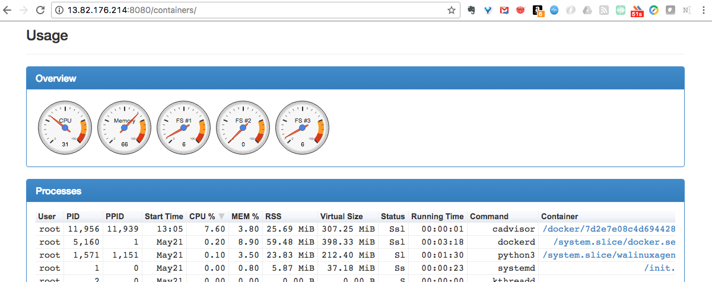
Docker Monitoring
https://github.com/google/cadvisor - Monitor the system from inside the Docker container!
sudo docker run --volume=/:/rootfs:ro --volume=/var/run:/var/run:rw --volume=/sys:/sys:ro --volume=/var/lib/docker/:/var/lib/docker:ro --publish=8080:8080 --detach=true --name=cadvisor google/cadvisor:latest
yourdockerhost:8080
Notes:
Page 73
https://github.com/google/cadvisor

Slide 74
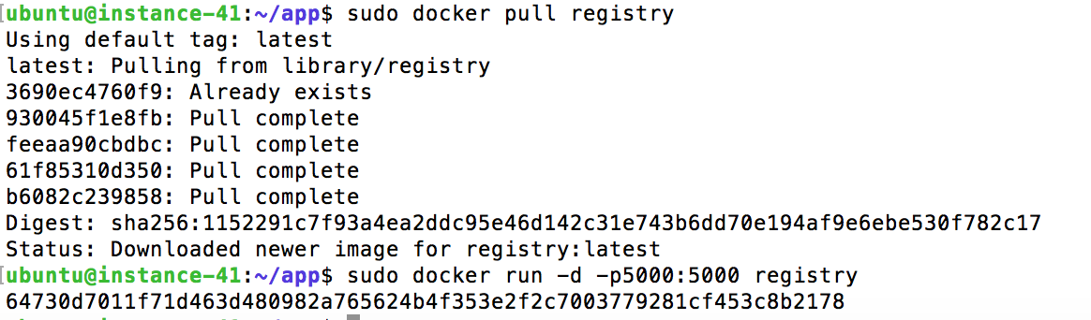
Running a Private Docker Registry
docker run -d -p5000:5000 registry
Push/Pull enabled from private registry
Notes:
Page 74
NOTES:

Slide 75
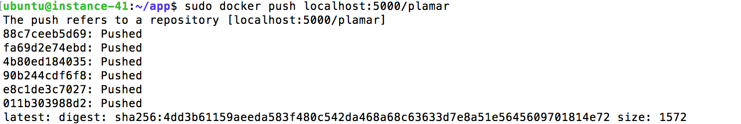
Docker Registry
Push a local image to a local registry
Docker push localhost:5000/<id>
https://github.com/docker/docker.github.io/blob/master/registry/deploying.md
Notes:
Page 75
https://github.com/docker/docker.github.io/blob/master/registry/deploying.md

Slide 76
Docker Registry
Search Registry
https://docs.docker.com/registry/spec/api/#listing-repositories
List Image Tags
https://docs.docker.com/registry/spec/api/#listing-image-tags
Notes:
Page 76
https://docs.docker.com/registry/spec/api/#listing-repositories
https://docs.docker.com/registry/spec/api/#listing-image-tags

Slide 77
Docker Volumes
Part 4

Slide 78
Data Volumes
A data volume is a specially-designated directory within one or more containers that bypasses the Union File System. Data volumes provide several useful features for persistent or shared data:
Volumes are initialized when a container is created. If the container’s base image contains data at the specified mount point, that existing data is copied into the new volume upon volume initialization. (Note that this does not apply when mounting a host directory.)
Data volumes can be shared and reused among containers.
Changes to a data volume are made directly.
Changes to a data volume will not be included when you update an image.
Data volumes persist even if the container itself is deleted.
Data volumes are designed to persist data, independent of the container’s lifecycle. Docker therefore never automatically deletes volumes when you remove a container, nor will it “garbage collect” volumes that are no longer referenced by a container.
Notes:
Page 78
NOTES:
Reference: http://nkhare.github.io/data_and_network_containers/Volumes/

Slide 79
Adding a Data Volume
You can add a data volume to a container using the -v flag with the docker create and docker run command. You can use the -v multiple times to mount multiple data volumes. Now, mount a single volume in your web application container.
docker run -d -P --name web -v /webapp training/webapp python app.py
This will create a new volume inside a container at /webapp.
In addition to creating a volume using the -v flag you can also mount a directory from your Docker engine’s host into a container
docker run -d -P --name web -v /src/webapp:/webapp training/webapp python app.py
This command mounts the host directory, /src/webapp, into the container at /webapp.
Notes:
Page 79
NOTES:

Slide 80
Volume Persistence
Docker –v flag can mount the volume to a specific directory
Notes:
Page 80
docker run -v /volumetesting --name="persistdata" ubuntu /bin/sh -c "echo testing persistence with volumes > /volumetesting/textfile.txt”
docker run --volumes-from=persistdata ubuntu /bin/sh -c "cat /volumetesting/textfile.txt"

Slide 81
Docker Volume Commands
Command | Description
docker volume create | Create a volume
docker volume ls | List volumes
docker volume inspect | Detailed information on volume
docker volume rm | Remove volume
Notes:
Page 81
NOTES:

Slide 82
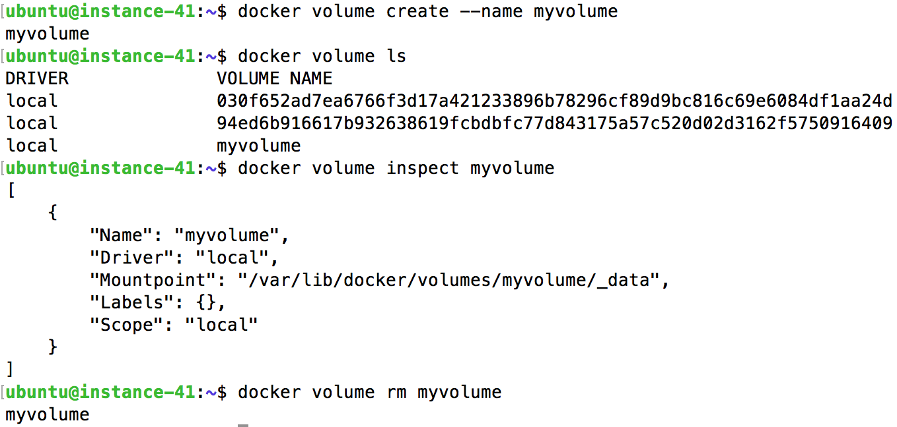
Working with Volumes
Notes:
Page 82
NOTES:

Slide 83
Dangling Volumes
If container is deleted with a volume attached, the volume remains. Sometimes removing all such ‘dangling’ volumes is desired
$ docker volume prune
Notes:
Page 83
$ docker volume prune

Slide 84
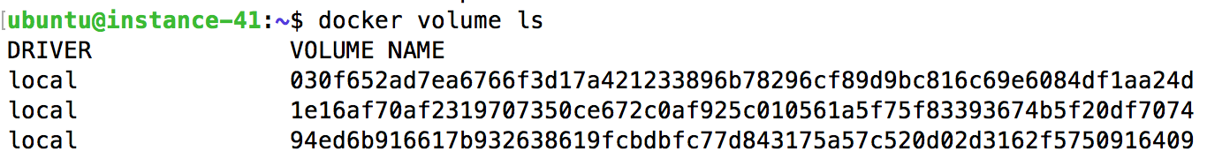
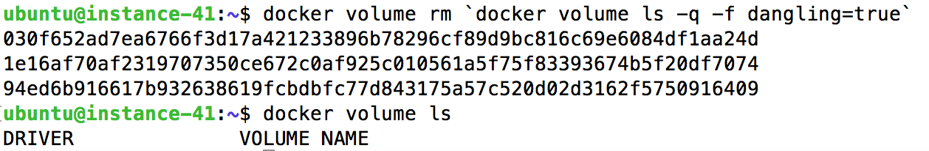
Dangling Volumes
Before
After
Notes:
Page 84
NOTES:

Slide 85
Docker Volumes Exercise
4.1 CLASSROOM WORK
https://github.com/shekhar2010us/docker_bootcamp/blob/master/exercise/exercise4.1-docker-volumes.md
Notes:
This is a nice full volumes exercise that shows volume persistence, cross-container volumes, etc.
https://github.com/shekhar2010us/docker_bootcamp/blob/master/exercise/exercise4.1-docker-volumes.md
Page 85

Slide 86
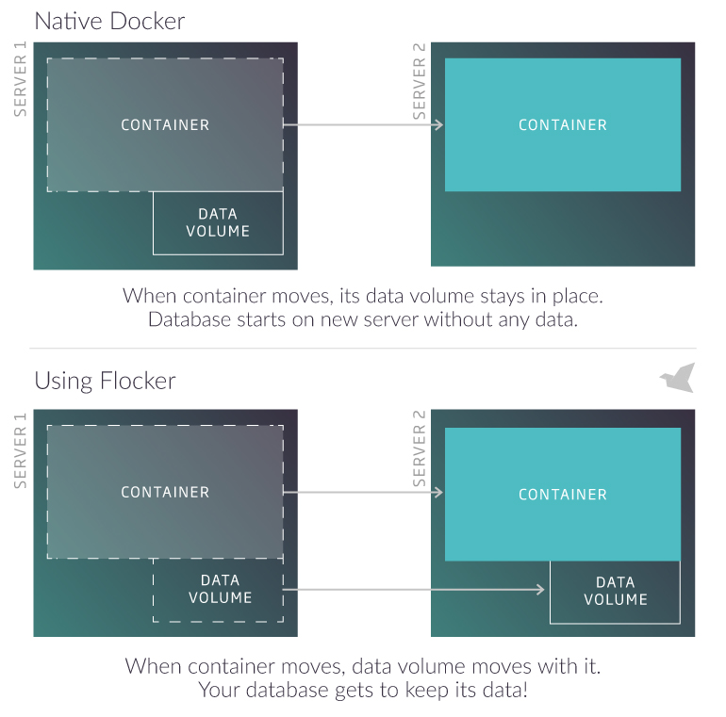
Docker Volume Plugin - Flocker
https://clusterhq.com/flocker/
Notes:
Page 86
NOTES:

Slide 87
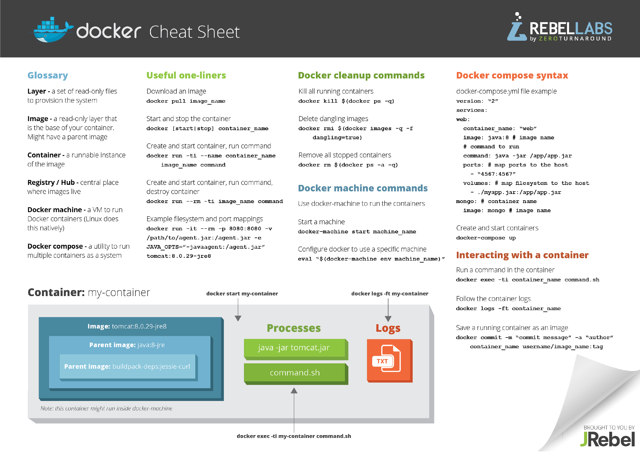
Docker Cheat Sheet
Notes:
Page 87
Printable sheet available at:
https://zeroturnaround.com/rebellabs/docker-commands-and-best-practices-cheat-sheet/

Slide 88
Docker Compose/Swarm
Part 5

Slide 89
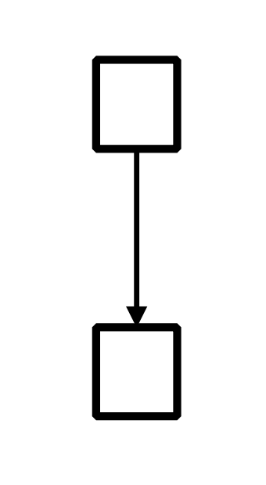
Launching Multiple Containers is Clumsy
$ docker pull redis:latest
$ docker build -t web .
$ docker run -d --name=db redis:latest redis-server --appendonly yes
$ docker run -d --name=web --link db:db -p 5000:5000 -v `pwd`:/code web python app.py
Notes:
Page 89
NOTES:

Slide 90
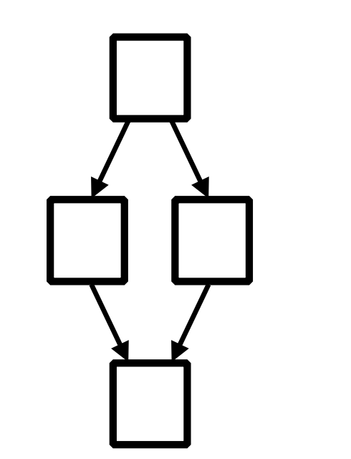
Launching Multiple Containers is Clumsy
$ docker pull ...
$ docker pull ...
$ docker build ...
$ docker build ...
$ docker run ...
$ docker run ...
$ docker run ...
$ docker run ...
Notes:
Page 90
NOTES:

Slide 91
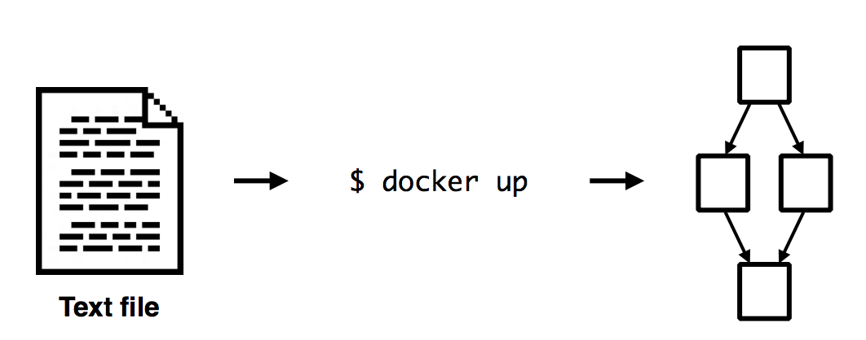
Docker Compose or Swarm Launches app with a single command
$ docker-compose up
$ docker stack deploy
Notes:
Page 91
NOTES:

Slide 92
Docker Compose Commands
Command | Description
docker-compose up | (Re)build services
docker-compose kill | Kill the containers
docker-compose logs | Show the logs of the containers
docker-compose down | Stop and remove images, containers, volumes and networks
docker-compose rm | Remove stopped containers
Notes:
Page 92
NOTES:

Slide 93
Docker Compose to Deploy a Cluster
5.1 CLASSROOM WORK
First, install Compose:
https://github.com/docker/compose/releases
$ curl -L https://github.com/docker/compose/releases/download/1.23.2/docker-compose-`uname -s`-`uname -m` -o /usr/local/bin/docker-compose
$ chmod +x /usr/local/bin/docker-compose
Then, Compose “Getting Started” Lab:
https://github.com/shekhar2010us/docker_bootcamp/blob/master/exercise/exercise5.1-docker-compose.md
Notes:
This exercise shows how docker-compose can be used to deploy a multi-container app in one step against a single docker daemon.
Very useful for development, test, and CI environments.
https://github.com/shekhar2010us/docker_bootcamp/blob/master/exercise/exercise5.1-docker-compose.md
Page 93

Slide 94
Docker Swarm Commands
Command | Description
docker swarm init | Create a swarm
docker stack deploy | Deploy the swarm
docker stack services | Show swarm services
docker stack rm | Remove stack
Notes:
Page 94
NOTES:

Slide 95
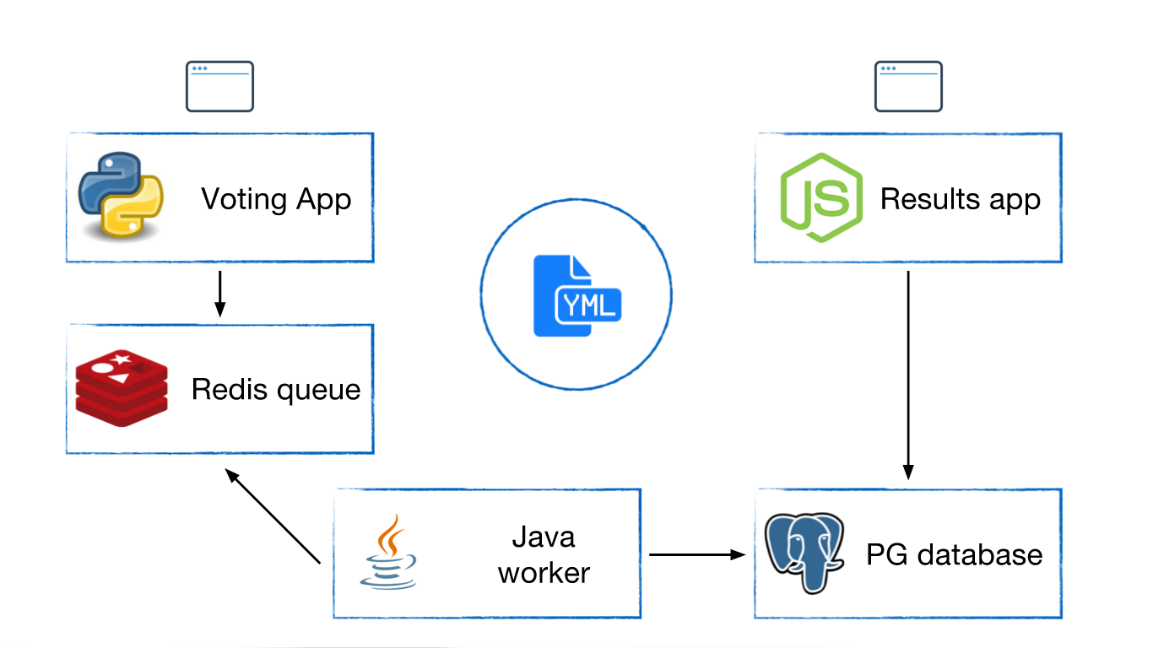
Docker Swarm to Deploy a Cluster
5.2 CLASSROOM WORK
Exercise 3.0 in Docker Labs
https://github.com/shekhar2010us/docker_bootcamp/blob/master/exercise/exercise5.2-voting-app.md
Notes:
Page 95
Imagine what it would take to support something like American Idol’s voting system… you’d probably define a similar architecture.

Slide 96
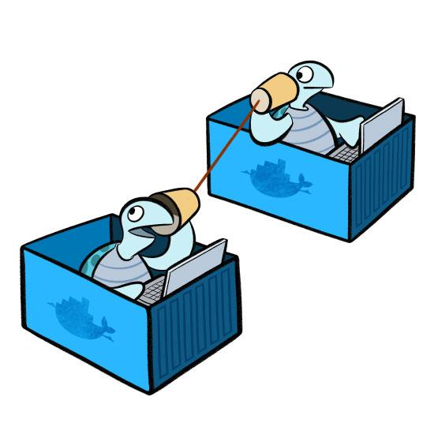
Docker Networking
Notes:
Page 96
NOTES:

Slide 97
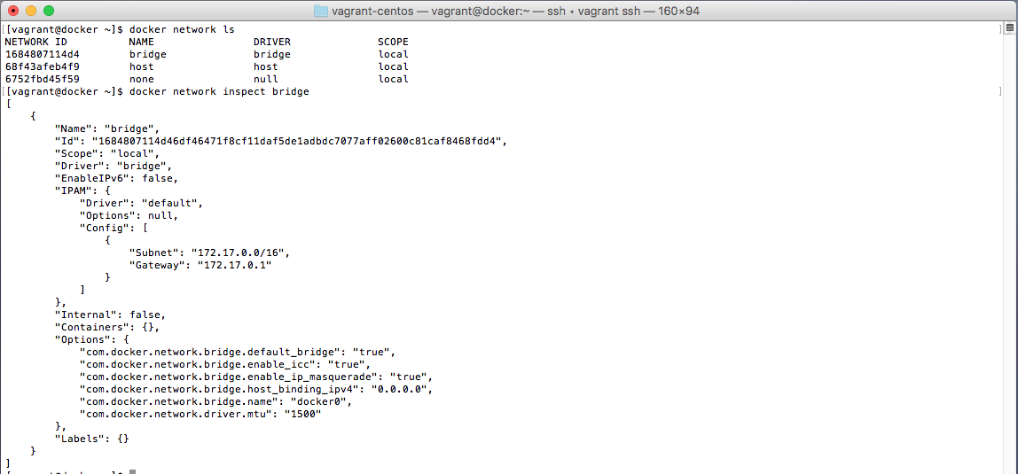
Docker Network Defaults
Three networks are created by default (bridge, host & none)
docker network ls
We can easily inspect the bridge network
docker network inspect bridge
We see that a 172.17.0.0/16 address space is allocated. Created Containers are given an IP in this space by default.
Notes:
Page 97
$ docker network ls
$ docker network inspect bridge

Slide 98
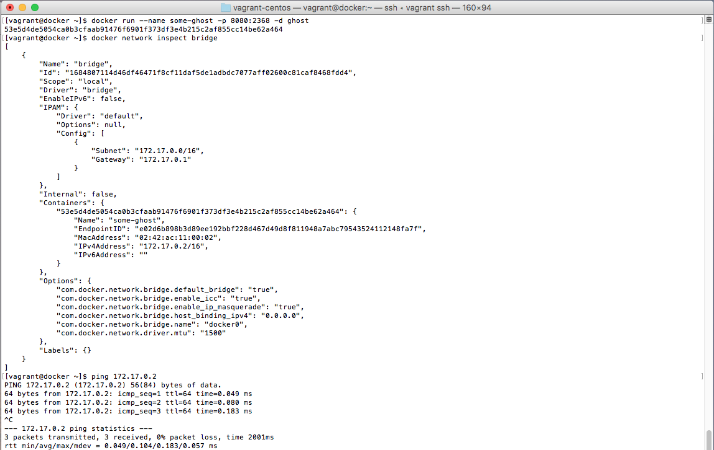
Docker Network Defaults
Created container is attached to bridge network by default
Can be attached to user created networks as well with –network flag
Container is assigned 172.17.0.2 ip in the bridge network and appears in the docker inspect command
The container can then be pinged at 172.17.0.2
Notes:
Page 98
docker run --name some-ghost -p 8888:2368 -d ghost
docker inspect network bridge
ping 172.17.0.2
Note: The ‘some-ghost’ container is still exposed at <ip>:8888 through use of the –p 8888:2368 flag and argument
Read more about docker networking
https://docs.docker.com/engine/userguide/networking/

Slide 99
Docker Network Commands
Command | Description
docker network create | Create a network
docker network ls | List networks
docker network inspect | Detailed information on network
docker network rm | Remove network
docker network disconnect | Disconnect container from network
docker network connect | Connect container to network
Notes:
Page 99
Commands follow the same general pattern as docker volume.
More documentation available at
https://docs.docker.com/engine/userguide/networking/

Slide 100
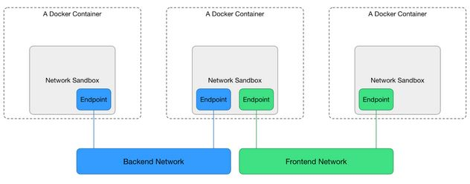
Isolated User Networks
The bridge network is useful in a development environment
Production environments usually require more security and isolated or more customized networking solutions.
Docker network (libnetwork) and the swarm mode overlay network type provide the building blocks to do so.
Notes:
Page 100
NOTES:

Slide 101
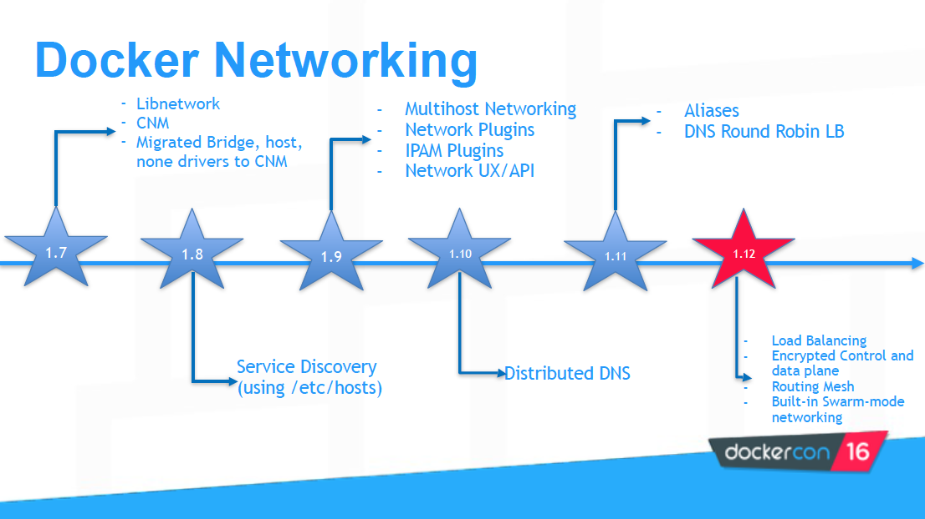
Docker Network Releases
Notes:
Page 101
Reference:
http://www.slideshare.net/Docker/docker-networking-deep-dive
Docker has recently added quite a few networking features on top of their Libnetwork functionality. These use cases have traditionally been served by Docker networking plugins such as Weave, Flannel, Calico, and OpenVSwitch.

Slide 102
Docker Network Releases: New in 1.13+
Add --attachable network support to enable docker run to work in swarm-mode overlay network
Add support for host port PublishMode in services using the --publish option in docker service create
Notes:
Page 102
Reference: https://github.com/docker/docker/releases/tag/v1.13.0

Slide 103
Docker Overlay Networks
Overlay networking for Docker Engine swarm mode comes secure out of the box. By default all nodes encrypt and authenticate network information they exchange using the AES algorithm in GCM mode. Manager nodes in the swarm rotate the key used to encrypt gossip data every 12 hours.
You can also encrypt data exchanged between containers on different nodes on the overlay network. When you enable overlay encryption, Docker creates IPSEC tunnels between all relevant* nodes attached to the overlay network. These tunnels also use the AES algorithm in GCM mode and manager nodes automatically rotate the keys every 12 hours.
To enable encryption, when you create an overlay network pass the --opt encrypted flag:
$ docker network create --opt encrypted --driver overlay my-multi-host-network
Notes:
Page 103
*The swarm makes the overlay network available only to nodes in the swarm that require it for a service. When you create a service that uses the overlay network, the manager node automatically extends the overlay network to nodes that run service tasks.
Reference:
https://docs.docker.com/engine/userguide/networking/overlay-security-model/

Slide 104
Docker Patterns
Part 6

Slide 105

Docker Patterns
Notes:
Page 105
NOTES:

Slide 106

Jenkins Continuous Integration-Cloudbees
Link to Blog: Clustering Jenkins
http://bit.ly/2a092Xo
Notes:
The gist is that Jenkins master runs from a Docker image and is part of a Kubernetes Jenkins cluster. The master itself must have its own persistent storage where the $JENKINS_HOME with all of its credentials, plugins, and job/system configurations can be stored. This separation of master and $JENKINS_HOME into 2 locations allows the master to be fungible and therefore easily replaced should it go offline and need to be restarted by Kubernetes. The important “guts” that make a master unique all exist in the $JENKINS_HOME and can be mounted to the new master container on-demand. Kubernetes own load balancer then handles the re-routing of traffic from the dead container to the new one.
Page 106

Slide 107

According to Michael Duke
Link to Blog: Docker as Jenkins Build Solution
http://bit.ly/2a57Za8
Notes:
Page 107
This blog post describes using the Docker Plugin for Jenkins to allow Jenkins to provision new containers which act as Jenkins slaves and compile code for a particular version of the popular Hybris eCommerce platform.
This solved several problems:
Hybris can only compile one application at a time, so developers often ended up waiting in queues (up to 45+ minutes) to see the result of the code in the application.
Hybris cannot cross-compile applications for different versions of the platform, so separate slaves are required for each version
Using Docker solves these problems by allowing a new lightweight application server to be spun up for each code commit… the container contains the correct version of Hybris for the branch the code comes from as well as a Jenkins slave to start the compilation.

Slide 108

According to Julia Mateo
Link to Presentation: Continuous Delivery
http://bit.ly/2aHZj9o
Notes:
Page 108
This presentation describes a workflow for true Continuous Deployment using Jenkins with the Docker plugin to publish images and the SSH plugin to pull images onto production environments. The code must first pass code quality tests in SonarQube (formerly Sonar) and artifacts are stored using Nexus. A Blue/Green / Canary routing model allows new code to be gradually moved to the bulk of users, and allows for user-selection of application version, if desired.

Slide 109

Docker and Jenkins
Docker and Jenkins, a popular open source continuous integration tool, is a fairly common pattern, enough so that it is worth going into an example.
Spin up Jenkins in a Docker Container
Enable Jenkins to create other containers on the Docker Host computer
Notes:
Page 109
It would be useful to orchestrate Docker containers with an automation tool. This allows us to create a variety of helpful automation including continuous integration pipelines for example.
In order to do so, we must figure out how to create containers from another application. Next we will walk through an example to do so.

Slide 110
How to run a ‘Host’ Docker command inside a ‘Client’ Docker container?
Mount a Docker socket
Issuing a Docker run command with the Docker socket will enable you to manage host containers from within the client container
‘docker run –v /var/run/docker.sock:/var/run/docker.sock’
Notes:
Page 110
You can run the following command if you would like a fully functional example of this behavior.
docker run -it -v /var/run/docker.sock:/var/run/docker.sock ubuntu:latest sh -c "apt-get update ; apt-get install docker.io -y ; bash"
Once in this container, you can execute docker commands on the host such as ‘docker ps’ or ‘docker run ubuntu /bin/echo 'Hello world’’
Remember our syntax from docker volumes, this is mapping the host /var/run/docker.sock to the client container /var/run/docker.sock
Finally, consider the security aspects if doing this in a non-developer situation as the client container has access to all the other running containers. An attacker could access the socket and create another container to mount /etc/ and gain root access to the host, so it is wise to be careful when mounting docker.sock into a container.

Slide 111
Docker and Jenkins, Part 1
6.1 CLASSROOM WORK
Part 1, Jenkins Exercise in Docker Tutorials
This assignment is to set up a dockerfile that uses an official Jenkins image from Docker Hub, build an image with that image as a starting point, run a Jenkins container using the new image, and successfully get a Docker Hello world container running on the host but orchestrated from Jenkins in the container.
This exercise will help you practice Docker volume syntax as well as configure a client container (our Jenkins container) such that it can make calls to its host Docker engine.
Estimated time to complete: 20-30 min
Solution:
https://github.com/shekhar2010us/docker_bootcamp/blob/master/exercise/exercise6.1-jenkins-part1.md
Notes:
Page 111
Jenkins Exercise in docker-tutorials is an example that will enable you to leverage Docker to easily setup and run Jenkins. Furthermore, by setting up a volume that is a shared docker.sock, you will give this container the capability to execute Docker commands on the host machine.
https://github.com/shekhar2010us/docker_bootcamp/blob/master/exercise/exercise6.1-jenkins-part1.md

Slide 112

Sharing Persistent Volumes
Notes:
Page 112
NOTES:

Slide 113
Docker and Jenkins, Part 2
6.2 CLASSROOM WORK
Part 2, Shared Volumes Exercise in Docker workshop
The second assignment is to successfully share a persistent storage volume between two different Jenkins containers. Simulate the scenario of restoring your Jenkins state after a failure of the first container using the storage volume.
This exercise of sharing volumes could be extended to some simple open source databases as well.
Estimated time to complete: 15-25 min
Solution:
https://github.com/shekhar2010us/docker_bootcamp/blob/master/exercise/exercise6.2-jenkins-part2.md
Notes:
This exercise expands on the ideas in the previous Jenkins Exercise setting up cross-container sharing of persistent volumes.
https://github.com/shekhar2010us/docker_bootcamp/blob/master/exercise/exercise6.2-jenkins-part2.md
Page 113

Slide 114
Docker and Jenkins, Part 3
6.3 CLASSROOM WORK
Part 3, Set up a Continuous Integration example.
Get a three-stage continuous integration pipeline working within your Jenkins container. This may involve installing additional plugins to your Jenkins instance (automate within your dockerfile) and adjusting the permissions on the Docker run command.
Estimated time to complete: 20-30 min
Solution:
https://github.com/shekhar2010us/docker_bootcamp/blob/master/exercise/exercise6.3-jenkins-part3.md
Notes:
A Continuous Integration pipeline is the first step in many development projects.
https://github.com/shekhar2010us/docker_bootcamp/blob/master/exercise/exercise6.3-jenkins-part3.md
Page 114

Slide 115
Docker and Jenkins, Part 4
CLASSROOM WORK
Part 4, Call Continuous Integration Container from Docker Compose
Take the working code from Part 3 and summarize it with a call to Docker Compose. Docker Compose is a much more convenient interface and scales better when multiple containers must be invoked.
Bonus: Configure Jenkins container to skip setup workflow
Estimated time to complete: 15-25 min
Solution:
https://github.com/shekhar2010us/docker_bootcamp/blob/master/exercise/exercise6.4-jenkins-part4.md
Notes:
https://github.com/shekhar2010us/docker_bootcamp/blob/master/exercise/exercise6.4-jenkins-part4.md
Page 115
NOTES:

Slide 116


According to Mischa Taylor
Link to Blog: Survey of Test Kitchen Providers
http://bit.ly/2a56kS2
Notes:
Page 116
This blog post shows some ways to get the Chef SCM Test Kitchen test harness environment running against various deployment environments, including a Docker-based system.

Slide 117


According to Rancher
Link to Blog: Docker-based Build Pipelines
http://bit.ly/2aHtu0K
Notes:
Page 117
This blog post discusses using Jenkins and Docker to build a CI pipeline based around the git-flow branching model (with develop(ment) branch and master branch).

Slide 118

According to Robert Greiner
Link to Blog: Continuous Integration with Docker
http://bit.ly/2aeA1io
Notes:
Page 118
This blog post describes a CI/CD pipeline. The pipeline features container re-use throughout the cycle and allows a blue/green deployment.
Developer commits code to version control
Continuous Integration tool (Jenkins) triggers on check-in, tests the changes, and builds a Docker Image
Jenkins submits new version of Image to Registry
Docker Container is built and executed on QA server for testing
Testing begins in Non-Prod / Prod environments
Container is promoted to Staging server after successful tests
Container is promoted to “Blue” Production environment (non-live) after successful tests
Container is promoted to “Green” Production release, after successful tests, and is live
User access new functionality

Slide 119

According to Vallard
Link to Blog: Continuous Delivery of a Simple Web Application
http://bit.ly/2asS8G3
Notes:
Page 119
This blog post is structured as a tutorial and walks you through building a CI pipeline to deliver a web app. It features Jenkins CI and tight Slack integration for high visibility.

Slide 120

Docker Adoption & Usage Data
Notes:
Page 120
NOTES:

Slide 121

Docker Adoption & Usage Data
Notes:
Page 121
NOTES:

Slide 122

Local Docker Development
Notes:
Page 122
NOTES:

Slide 123

MacOS & Windows - The Old-Old Way
Vagrant Recipe for Local Docker Dev
Install Vagrant https://www.vagrantup.com/
Install VirtualBox https://www.virtualbox.org/wiki/Downloads
Git clone https://github.com/russmckendrick/monitoring-docker.git
Enter vagrant-centos dir
cd vagrant-centos
Launch Centos VM (with docker installed)
vagrant up
Connect to Centos VM
vagrant ssh
Verify success!
docker run hello-world
Notes:
Page 123
The vagrant files provided in this project:
https://github.com/russmckendrick/monitoring-docker
Are excellent
https://github.com/russmckendrick/monitoring-docker/blob/master/vagrant-centos/Vagrantfile
In addition, they give the VM a static IP of 192.168.33.10. This makes it much more convenient to access your containers from your host PC through the VM. For example, if you ran ‘docker run --name some-ghost -p 8080:2368 -d ghost’ on this VM, you could then access the container ghost program at: 192.168.33.10:8080 in the internet browser of your host MacOS or Windows machine. This makes local development much easier and a more pleasant experience if you don’t have a dedicated Linux machine at all times.

Slide 124

MacOS & Windows - The Less-Old Way
Use Docker Toolbox / Machine Locally
Ideal for older Mac and Windows systems that do not meet the requirements of Docker for Mac or Docker for Windows.
Install Docker Toolbox https://docs.docker.com/toolbox/overview/
This one step gets you:
Native Docker CLI client
VirtualBox
Docker Machine (which can bring up a local Linux VM using VirtualBox)
Docker Compose
Kitematic (Docker GUI)
Docker QuickStart shell
Notes:
Page 124
NOTES:

Slide 125

MacOS & Windows - The New Way
Docker for Mac / Docker for Windows
Simple one-step install
Docker for Mac requires Mac OS 10.11 or newer running on 2010 or newer Mac hardware
Docker for Windows requires 64bit Windows 10 Pro Enterprise and Education and Microsoft Hyper-V
Both tools provide the full Docker environment as well as a convenient GUI for managing volumes, utilization, and networking
Under the hood, it’s docker-machine
Notes:
Page 125
NOTES:

Slide 126

Docker Machine -
Docker Engine Provisioning
Machine lets you create Docker hosts on your computer, on cloud providers, and inside your own data center. It creates servers, installs Docker on them, then configures the Docker client to talk to them. It also can provision Swarm clusters.
$ docker-machine create \ -d virtualbox default
$ docker-machine create \ -d digitalocean \ --digitalocean-access-token xxxxx \ docker-sandbox
$ docker-machine create -d amazonec2 \ --amazonec2-access-key AKI******* \ --amazonec2-secret-key 8T93C******* \ aws-sandbox
Local and Cloud drivers available
Notes:
Page 126
When you install Docker Machine, you get a set of drivers for various cloud providers (like Amazon Web Services, Digital Ocean, or Microsoft Azure) and local providers (like Oracle VirtualBox, VMWare Fusion, or Microsoft Hyper-V).
https://docs.docker.com/machine/get-started-cloud/

Slide 127
New in Docker for Windows / Docker 1.13
Native Windows Containers
Certain very new versions of “Windows 10 Pro Enterprise and Education” and “Windows Server 2016” now have Windows kernels that support containerization and can be used to run native Windows Containers that run Windows applications in a container environment
Requires Docker for Windows, and supports shared-kernel (“Windows Server Containers”) and VM-based (“Hyper-V Containers”)
Notes:
Page 127
NOTES:

Slide 128
Docker Security
Part 7

Slide 129
Security For Docker Images
Secure Registry/Mirror Access
Getting trustworthy images
Trusted sources
docker hub / docker store
official images
pull by digest
private registry
Building secure
Docker Content Security
Docker Notary
Digitally signed images
"only signed content in production"
Yubico Keys can be used for code signing
Notes:
Page 129
NOTES:

Slide 130
Docker Content Trust
7.1 CLASSROOM WORK
In this exercise, we’ll learn how to enable Docker Content Trust and sign images.
https://github.com/shekhar2010us/docker_bootcamp/blob/master/exercise/exercise7.1-docker-security.md
(Step 3.4 requires an active Docker Hub account… easy to acquire with just an email address.)
Notes:
https://github.com/shekhar2010us/docker_bootcamp/blob/master/exercise/exercise7.1-docker-security.md
Page 130
NOTES:

Slide 131

Docker Bench Security
Docker Bench is an automated script that checks for dozens of best-practices around deploying Docker in production
https://github.com/docker/docker-bench-security
Run with the following command (available at the github page above)
docker run -it --net host --pid host --cap-add audit_control \
-v /var/lib:/var/lib \
-v /var/run/docker.sock:/var/run/docker.sock \
-v /usr/lib/systemd:/usr/lib/systemd \
-v /etc:/etc --label docker_bench_security \
docker/docker-bench-security
Notes:
Page 131
1.1 – Creating a separate partition for containers – mapping /var/lib/docker to a separate partition
2.1 – Restricting network traffic – pass icc=false to the Docker daemon startup process
2.5 – Do not use the aufs storage driver – Use the appropriate storage driver for the OS of the Docker host
4.1 - Create a user for the container – Run containers as non-root users
5.7 – Do not run ssh within containers – Use tools provided by Docker to access containers including docker exec, etc

Slide 132


Docker Bench Results Discussion
Review Docker Security white paper: https://d3oypxn00j2a10.cloudfront.net/assets/img/Docker%20Security/WP_Intro_to_container_security_03.20.2015.pdf
Points to consider:
Security is one of the most difficult areas of IT for which to prescribe solutions
Security is often misunderstood or de-prioritized by the business
Which is the strongest recommendation from the Docker Bench Results list? Most surprising?
Which, if any, do you disagree with?
Discussion
15
min
Discuss
Notes:
We will engage in this discussion if time permits. If we do not, please feel free to look over the materials on your own and consider the questions above.
Page 132

Slide 133
(Some) Docker Security Best Practices
Access to Docker host = full access to all running containers and any new ones
Docker containers can attach to volumes in read only mode with :ro option
Docker run –d –v /some/volume:ro jenkins
Start Docker containers with the -u flag so that they run as an ordinary user instead of root. Consider dropping SUID support entirely in production containers
Mitigate DoS by limiting CPU, RAM, Sockets that each container can consume
Use secure computing (seccomp) to block system calls at kernel level. Use strace to determine kernel calls made, then create a profile file in json format and start the container using that profile file
docker run --rm -it --security-opt seccomp=custom_profile.json custom_app
Log to stdout / stderr - so you can see with docker logs and docker can move to syslogs (for capture/rotate by ELK, etc.)
Notes:
Page 133
http://training.play-with-docker.com/security-seccomp/

Slide 134
Docker Security
Stay up to date with the discussion at Docker’s user group, forum, github issues, and IRC channel
https://groups.google.com/forum/#!forum/docker-dev
https://forums.docker.com/
https://github.com/docker/docker/issues
https://docs.docker.com/opensource/get-help/
IRC #docker & #docker-dev
Notes:
Page 134
https://groups.google.com/forum/#!forum/docker-dev

Slide 135
Docker Security Scanning
(formerly Project Nautilus)
Docker Security Scanning conducts binary level scanning of your images before they are deployed, provides a detailed bill of materials (BOM) that lists out all the layers and components, continuously monitors for new vulnerabilities, and provides notifications when new vulnerabilities are found.
Available for private Docker Hub repositories (potentially free)
Available as a paid service to Docker Cloud customers, maintainers of “Official” repositories on Docker Hub, and Docker EE Advanced
Notes:
https://blog.docker.com/2016/05/docker-security-scanning/
https://github.com/docker/labs/blob/master/security/scanning/README.md
Page 135

Slide 136
Clair by CoreOS
Robust free and open source image security scanning tool
https://github.com/coreos/clair
Static analysis of images for known vulnerabilities
Integrates into CI pipelines
Notes:
Page 136
https://blog.quay.io/security­ scanning­beta/
https://coreos.com/blog/vulnerability­analysis­for­ containers/

Slide 137
Swarm Mode Security
Swarm Mode was designed with security in mind
Keys required to join a swarm
Key rotation features built-in
All node communications (management channel) are encrypted.
Certificates required for node communications
Certificate rotation features built-in
Overlay network management channel communications encrypted by default
Overlay network data may be easily encrypted by setting flag at network creation time
Key and certificate rotation features built-in
Notes:
Page 137
NOTES:

Slide 138
Swarm Security Basics
7.2 CLASSROOM WORK
In this exercise, we’ll play with some of Swarm’s built-in service node management security features.
https://github.com/shekhar2010us/docker_bootcamp/blob/master/exercise/exercise7.2-docker-swarm-security.md
Notes:
https://github.com/shekhar2010us/docker_bootcamp/blob/master/exercise/exercise7.2-docker-swarm-security.md
Page 138
NOTES:

Slide 139
Secrets Management
ENV variables - NOT recommended
General-purpose Key/Value Pair solutions
Vault
Keywhiz
Embedded in orchestration
Docker 1.13+ - recommended
Kubernetes secrets - NOT recommended*
Custom solutions
Make sure you care as much as Docker et al.
Notes:
* As of 2016-11 https://www.conjur.com/blog/security-holes-persist-in-kubernetes-kubecon-2016-recap
Secrets are stored in plaintext on disks, etc.
Page 139

Slide 140
Swarm Secrets Management
7.3 CLASSROOM WORK
In this exercise, we’ll use Docker’s secrets objects to share a secret across nodes in a swarm.
Make sure your host is not participating in a swarm
docker swarm leave
Create (and join) a new swarm:
mkdir ~/secrets
cd ~/secrets
docker swarm init
https://github.com/shekhar2010us/docker_bootcamp/blob/master/exercise/exercise7.3-docker-secrets.md
Notes:
https://github.com/shekhar2010us/docker_bootcamp/blob/master/exercise/exercise7.3-docker-secrets.md
Page 140
NOTES:

Slide 141
What’s New in Docker 1.13+
https://blog.docker.com/2017/01/whats-new-in-docker-1-13/
Compose files for docker swarm deployment
Improved CLI backwards compatibility
Clean-up commands
CLI restructured - object->action
Monitoring improvements for services
--squash flag (flatten all newly built layers)
Docker for AWS and Azure out of beta
Secrets objects out of beta
Notes:
https://blog.docker.com/2017/01/whats-new-in-docker-1-13/
Page 141

Slide 142
Announced at DockerCon US 2017
Multi-stage Builds
Docker Google Cloud Platform beta available
LinuxKit available
Open source tool for building your own extraordinarily tiny and needs-specific Linux OS distributions
Image2Docker (for Native Windows Container dev)
Analyzes Windows VM files (VHD, VHDK, WIM and VMDK) and suggests dockerfile commands to replicate installed components
Oracle announces it will release their products into Docker Store
Persistent storage solutions abounded - EMC, StorageOS, Nimble*
Notes:
https://blog.docker.com/2017/04/introducing-linuxkit-container-os-toolkit/
Storage solutions as third party offerings becoming so popular might very well indicate that Docker will fold a storage solution into Docker Engine…. this has happened in the past.
Page 142

Slide 143
Docker is So Much Fun!
So easy to get started
Got an open-source or commercial service or application that you’re considering? Docker makes playing with researching it as easy as:
$ docker run coolnewtoy:latest
So easy to scale:
docker service scale webfrontend=5
Some more fun:
https://github.com/docker/dockercraft
https://www.youtube.com/watch?v=eZDlJgJf55o
Notes:
Page 143
NOTES:

Slide 144

Feedback Email
If you haven’t already, you will receive an email similar to the one here asking for your feedback on the course.
This Evaluation will ask your feedback on many aspects of your training, including the course materials, instructor facilitation and labs where applicable.
We appreciate you completing this survey to help us continue to better our content and deliveries in order to serve you better.

Slide 145



Questions

